Slide 1
Fundamentals of Computer Design - Trends and Performance
03
Kai Bu
kaibu@zju.edu.cn
http://list.zju.edu.cn/kaibu/comparch2022
Notes:
In the previous lecture session, we have walked though computer design basics such as computer classes and instruction set architectures.
Besides that, computer architects should also be aware of important trends in both the technology and the use of computers because such trends affect not only the future cost but also the longevity of an architecture.
In today’s lecture session, we’ll focus our review of computer design fundamentals on the evolution of trends and performance.

Slide 2
Fundamentals of Computer Design - Trends and Performance
How computer design trends evolve?
Notes:
First, we’ll walk through how did the trends in computer design evolve?
Why evolve compute design techniques?
toward a better performance, right?

Slide 3
Fundamentals of Computer Design - Trends and Performance
How computer design trends evolve?
Performance-driven: Quantitative
Notes:
And this, is exactly the core of quantitative approach, that is, performance-driven;
Quantitative research
“In natural and social sciences, and maybe in other fields, quantitative research is the systematic empirical investigation of observable phenomena via statistical, mathematical, or computational techniques.”

Slide 4
Fundamentals of Computer Design - Trends and Performance
How computer design trends evolve?
Performance-driven: Quantitative
how to measure performance?
how to improve performance?
Notes:
Then how do we measure computer performance?
In what ways can we improve performance?
All these questions will get answered in today’s discussions.

Slide 5
How do trends evolve?
Notes:
So first,
How do computer design trends evolve?

Slide 6
Trends
Technology
Power and Energy
Cost
Notes:
The evolving trends manifest in three major aspects,
they are technology, power and energy, and cost.

Slide 7
Trends
Technology
Power and Energy
Cost
Notes:
For technology,

Slide 8
Trends in Technology
5 implementation technologies:
Integrated circuit logic technology
Semiconductor DRAM
Semiconductor Flash
Magnetic disk technology
Network technology
Notes:
There are five rapidly changing implementation technologies that are critical to modern computer implementations;
Next, We’ll present their key properties or high level description;

Slide 9
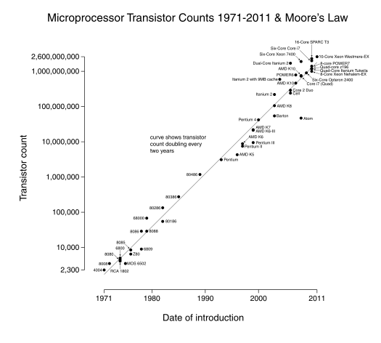
Integrated Circuit Logic
Moore’s Law: a growth rate in
transistor count
on a chip of about
40% to 55%
per year
doubles every
18 to 24 months
Notes:
A very important concept for integrated circuit logic technology is Moore’s law.
It captures the evolving trends of circuit capacity.
Specifically, it suggests that transistor count on a chip doubles about every two years.
You can clearly observe such trend from this figure.
(Historically, transistor density increased by about 35% per year, quadrupling somewhat over four years. Increases in die size are less predictable and slower, ranging from 10% to 20% per year. The combined effect was a traditional growth rate in transistor count on a chip of about 40%–55% per year, or doubling every 18–24 months.)

Slide 10
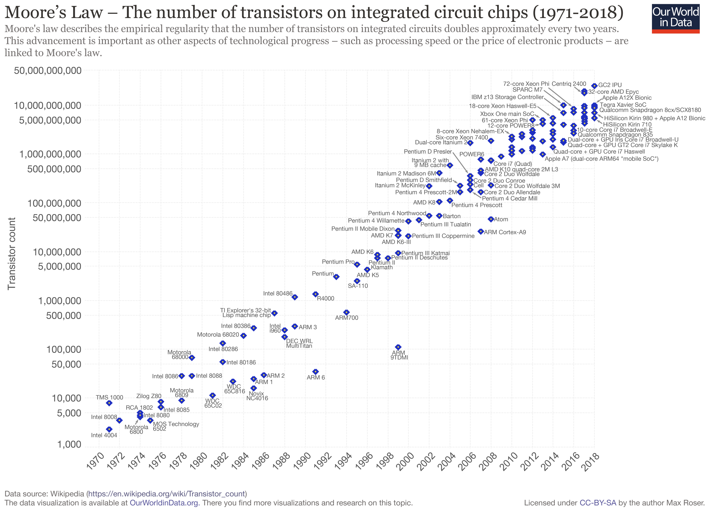
Moore’s Law
ended around 2015

Slide 11
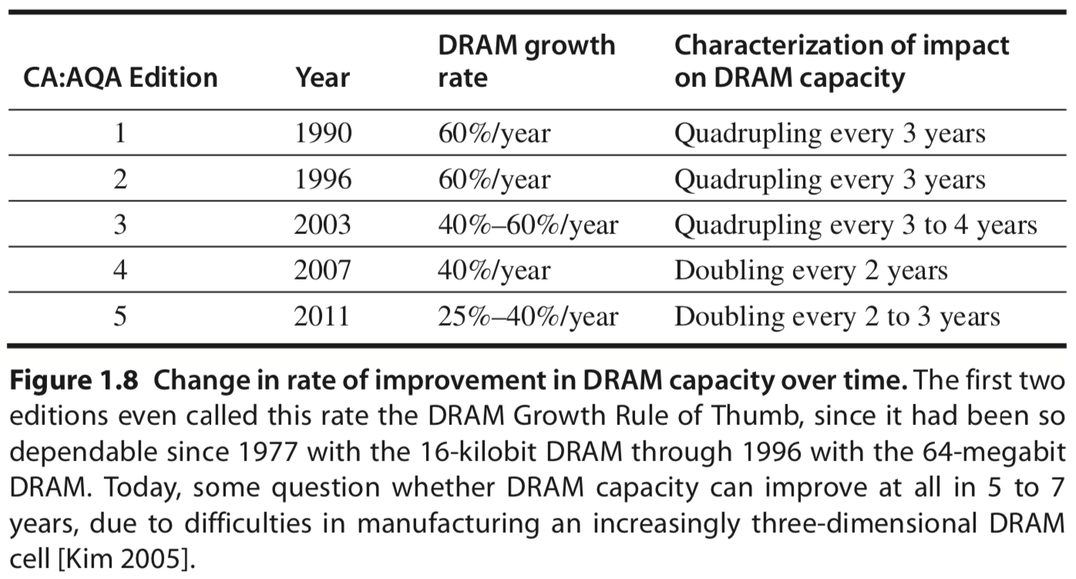
Semiconductor DRAM
Capacity per DRAM chip doubles roughly every 2 or 3 years [5th ed]
figure from 5th edition
Notes:
DRAM: Dynamic Random-Access Memory
As we mentioned previously, CPUs on chip work on various data to fulfill our commands.
However, our data stored on disks cannot be directly accessed by cpus;
Instead, they should be first loaded to main memory, where cpu can directly access.
The medium used as main memory is dram, i.e., dynamic random access memory;
As the table shows, capacity per dram chip doubles roughly every 2 or 3 years.
But keep in mind that when you power down the computer, the data in DRAM will be cleared.

Slide 12
Semiconductor DRAM
Capacity per DRAM chip quadruples roughly every 3 years [6th ed]
figure from 5th edition
Notes:
DRAM: Dynamic Random-Access Memory
As we mentioned previously, CPUs on chip work on various data to fulfill our commands.
However, our data stored on disks cannot be directly accessed by cpus;
Instead, they should be first loaded to main memory, where cpu can directly access.
The medium used as main memory is dram, i.e., dynamic random access memory;
As the table shows, capacity per dram chip doubles roughly every 2 or 3 years.
But keep in mind that when you power down the computer, the data in DRAM will be cleared.

Slide 13
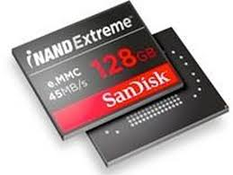
Semiconductor Flash
nonvolatile
EEPROM: Electronically Erasable Programmable Read-Only Memory
Standard storage devices in PMDs
Capacity per Flash chip doubles roughly every two years
8 to 10 times cheaper per bit than DRAM
Notes:
Then what medium do we use for permanent storage?
a currently popular one is flash, it uses EEPROM, it’s faster yet expensive than magnetic disk;
So it is more often used as storage devices in personal mobile devices.
Similarly, capacity per flash chip doubles roughly two years.

Slide 14
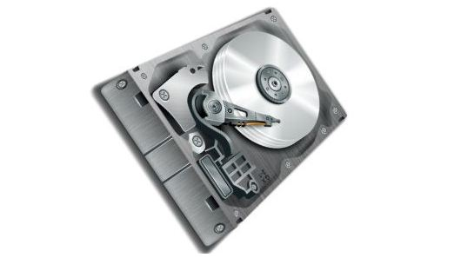
Magnetic Disk Technology
Between 2004 & 2011, density doubles every two years
recently, less than 5% per year;
8 to 10 times cheaper per bit than Flash
200 to 300 times cheaper per bit than DRAM
For server and warehouse scale storage
Notes:
For larger-scale permanent data storage, magnetic disk is still the mainstream device.
Between 2004 and 2011, Its density doubled every three years; recently, disk improvement has slowed to less than 5% per year.
It’s a lot cheaper than flash and dram, but it also has the slowest processing speed.
This technology is central to server- and warehouse-scale storage.

Slide 15

Network Technology
Switches
Transmission systems
Appendix F
Notes:
When putting a single computer into the larger context of network, we should also deal with a lot more design challenges like switches and transmission systems.
You can find more of their details in the course Computer Networks.
For interested students, trends in networking can be found in Appendix F.

Slide 16
Performance Trends
Bandwidth/Throughput
the total amount of work done in a given time
Latency/Response Time
the time between the start and the completion of an event
Notes:
for measuring the capacity and performance of the aforementioned computation, storage, and communication technology, we have two metrics to consider:
The first one is bandwidth or throughput, it is quantified as the total amount of work done in a given time; it represents the capacity of a device. (example: megabytes per second for a disk transfer)
The second one is latency or response time, which captures the time span between the start and the completion of an event. It more directly represents the performance of a device. (example, millionseconds for a disk access)

Slide 17
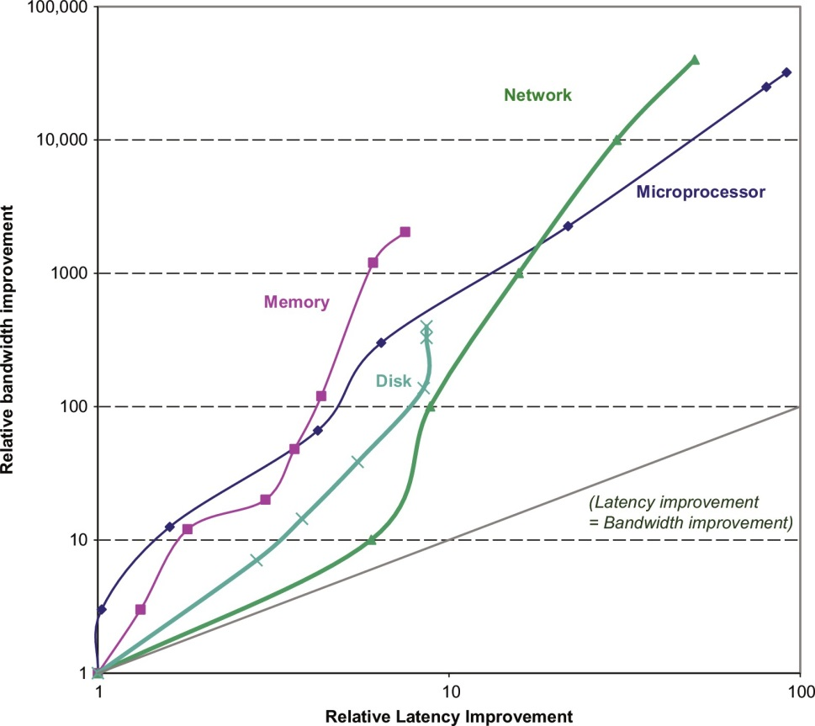
Bandwidth over Latency
Bandwidth grows by at least the square of
improvement in latency
Notes:
This figure plots the relative improvement in bandwidth and latency for technology milestones for microprocessors, memory, networks, and disks.
Observation: bandwidth improves much more than latency does.
Performance is the primary differentiator for microprocessors and networks, so they have seen the greatest gains: 32,000–40,000# in bandwidth and 50–90# in latency. Capacity is generally more important than performance for memory and disks, so capacity has improved more, yet bandwidth advances of 400–2400 # are still much greater than gains in latency of 8–9#.
Figure 1.9 Log-log plot of bandwidth and latency milestones in Figure 1.10 relative to the first milestone. Note that latency improved 8–91 #, while bandwidth improved about 400–32,000 #. Except for networking, we note that there were modest improvements in latency and bandwidth in the other three technologies in the six years since the last edition: 0%–23% in latency and 23%–70% in bandwidth. Updated from Patterson, D., 2004. Latency lags band- width. Commun. ACM 47 (10), 71–75.

Slide 18
Bandwidth over Latency
For microprocessors and networks
Performance is the primary differentiator:
32000~40000x in bandwidth
50~90x in latency
Notes:
This figure plots the relative improvement in bandwidth and latency for technology milestones for microprocessors, memory, networks, and disks.
Performance is the primary differentiator for microprocessors and networks, so they have seen the greatest gains: 32,000–40,000# in bandwidth and 50–90# in latency. Capacity is generally more important than performance for memory and disks, so capacity has improved more, yet bandwidth advances of 400–2400 # are still much greater than gains in latency of 8–9#.
Figure 1.9 Log-log plot of bandwidth and latency milestones in Figure 1.10 relative to the first milestone. Note that latency improved 8–91 #, while bandwidth improved about 400–32,000 #. Except for networking, we note that there were modest improvements in latency and bandwidth in the other three technologies in the six years since the last edition: 0%–23% in latency and 23%–70% in bandwidth. Updated from Patterson, D., 2004. Latency lags band- width. Commun. ACM 47 (10), 71–75.

Slide 19
Bandwidth over Latency
For memory and disks
Capacity is more important than performance
So capacity improved more
400~2400x in bandwidth
8~9x in latency
Notes:
Capacity is generally more important than performance for memory and disks
So capacity has improved most in the past years.

Slide 20
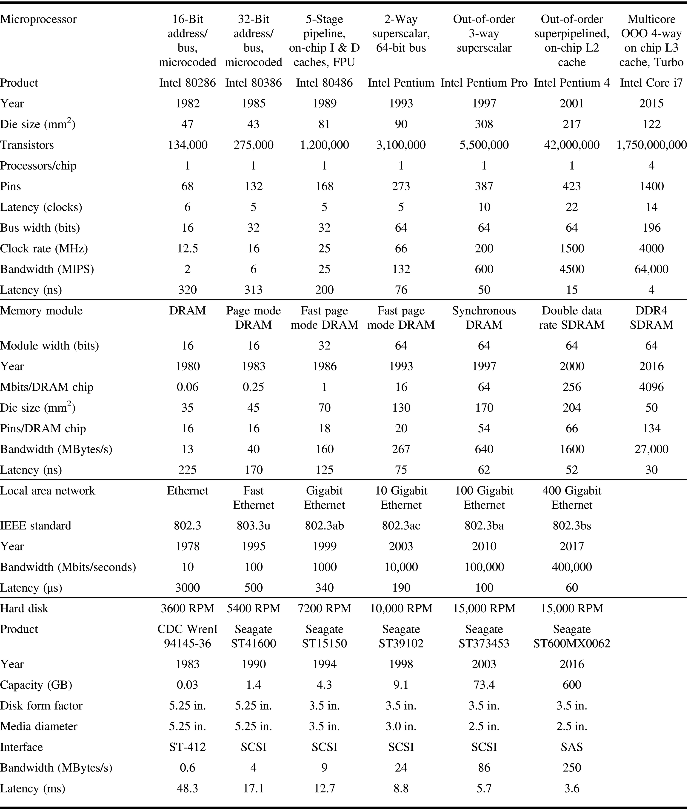
Performance Milestones
Notes:
This figure describes the examples and milestones in more detail.
Figure 1.10 Performance milestones over 25–40 years for microprocessors, memory, networks, and disks. The microprocessor milestones are several generations of IA-32 processors, going from a 16-bit bus, microcoded 80286 to a 64-bit bus, multicore, out-of-order execution, superpipelined Core i7. Memory module milestones go from 16-bit- wide, plain DRAM to 64-bit-wide double data rate version 3 synchronous DRAM. Ethernet advanced from 10 Mbits/s to 400 Gbits/s. Disk milestones are based on rotation speed, improving from 3600 to 15,000 RPM. Each case is best- casebandwidth,andlatencyisthetimeforasimpleoperationassumingnocontention. UpdatedfromPatterson,D., 2004. Latency lags bandwidth. Commun. ACM 47 (10), 71–75.

Slide 21
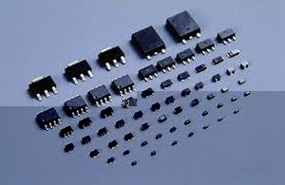
Transistor Performance and Wires
Feature Size is decreasing
minimum size of a transistor or a wire in either the x or y dimension
Transistor
performance
improves linearly with
decreasing feature size
Notes:
Finally, let’s discuss a bit more about the fundamental component/unit on chip, i.e., transistor.
Transistor becomes smaller and smaller, while its performance keeps improving.
The reason is that when transistor size shrinks, wires connecting transistors get shorter; this accelerates data transmission speed.
Moreover, when transistor shrinks, a chip can hold more transistors, which further improves the performance.
http://spiroprojects.com/blog/cat-view-more.php?blogname=Feature-Size-of-Transistors&id=483

Slide 22
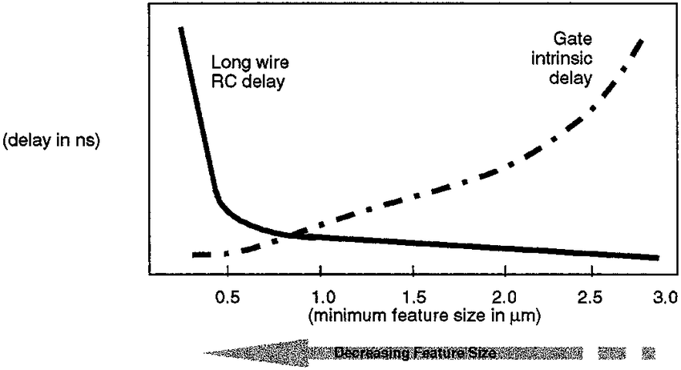
Transistor Performance and Wires
Feature size shrinks, wires get shorter;
resistance and capacitance per unit length get worse
Notes:
Finally, let’s discuss a bit more about the fundamental component/unit on chip, i.e., transistor.
Transistor becomes smaller and smaller, while its performance keeps improving.
The reason is that when transistor size shrinks, wires connecting transistors get shorter; this accelerates data transmission speed.
Moreover, when transistor shrinks, a chip can hold more transistor, which further improves the performance.
RC Delay: Bottleneck To Scaling https://semiengineering.com/rc-delay-bottleneck-to-scaling/#:~:text=RC%20delay%20%3D%20the%20delay%20in,functional%2C%20mobile%20consumer%20electronic%20devices.
Resistive-capacitive delay, or RC delay, hinders the further increasing of speed in microelectronic integrated circuits. https://en.wikipedia.org/wiki/RC_time_constant

Slide 23
Trends
Technology
Power and Energy
Cost
Notes:
Now let’s move to the second aspect: power and energy

Slide 24
Why power&energy matter?

Slide 25

Why power&energy matter?
power up computer
distribute power around the chip
dissipate heat to avoid overheating&failures

Slide 26
Power vs Energy
How to measure power?
Power = Energy per unit time
1 watt = 1 joule per second
energy to execute a workload =
avg power x execution time
Notes:
First, how to measure them?
The unit for measuring power is watt, while the unit for energy is joule
Actually, power is energy per unit time;
In other words, energy to execute a workload equals to avg power times execution time
In general, energy is always a better metric because it is tied to a specific task and the time required for that task.
Thus, if we want to know which of two processors is more efficient for a given task, we need to compare energy consumption (not power) for executing the task.

Slide 27
Energy Efficiency
Example
processor A with 20% higher avg power consumption than processor B;
but A executes the task with 70% of the time by B;
A or B is more efficient?
Notes:
Let’s use an example to better understand the relation between power and energy.

Slide 28
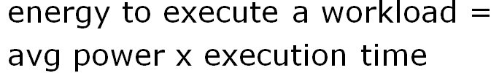
Energy Efficiency
Example
processor A with 20% higher avg power consumption than processor B;
but A executes the task with 70% of the time by B;
A or B is more efficient?
EnergyConsumptionA
= 1.2 x 0.7 x EnergyConsumptionB
=0.84 x EnergyConsumptionB
Notes:
Using the calculation method of energy, we can derive that energyconsumptionA is less than energyconsumptionB,
In this sense, we say that A is more efficient;

Slide 29
Where does the energy go?
Notes:
So where does the energy go within a microprocessor?

Slide 30
Primary Energy Consumption within a Microprocessor
Dynamic Energy:
switch transistors
energize pulse of the logic transition:
0->1->0 or 1->0->1
The energy of a single transition
0->1 or 1->0
Notes:
It is mainly for switching transistors, that is, energizing pulse of the logic transition.
Such Dynamic energy is proportional to the product of the capacitive load and the square of the voltage.

Slide 31
Power Consumption of a Transistor
Example
for microprocessors supporting adjustable voltage,
a 15% reduction in voltage may result in a 15% reduction in frequency;
impact on dynamic energy and power?

Slide 32
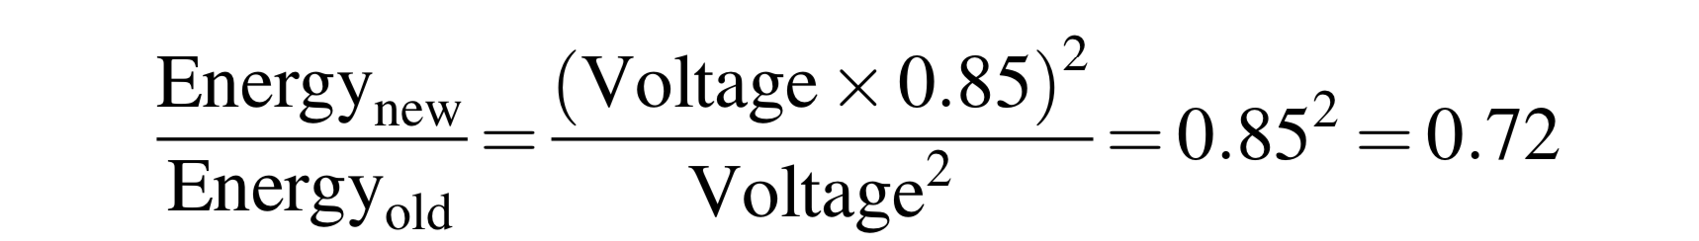
Power Consumption of a Transistor
Example
for microprocessors supporting adjustable voltage,
a 15% reduction in voltage may result in a 15% reduction in frequency;

Slide 33
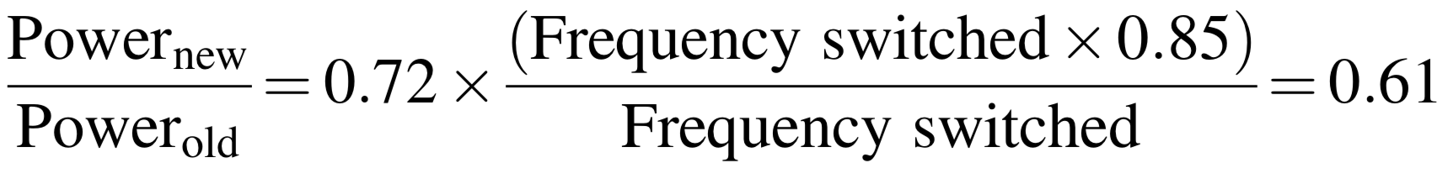
Power Consumption of a Transistor
Example
for microprocessors supporting adjustable voltage,
a 15% reduction in voltage may result in a 15% reduction in frequency;

Slide 34
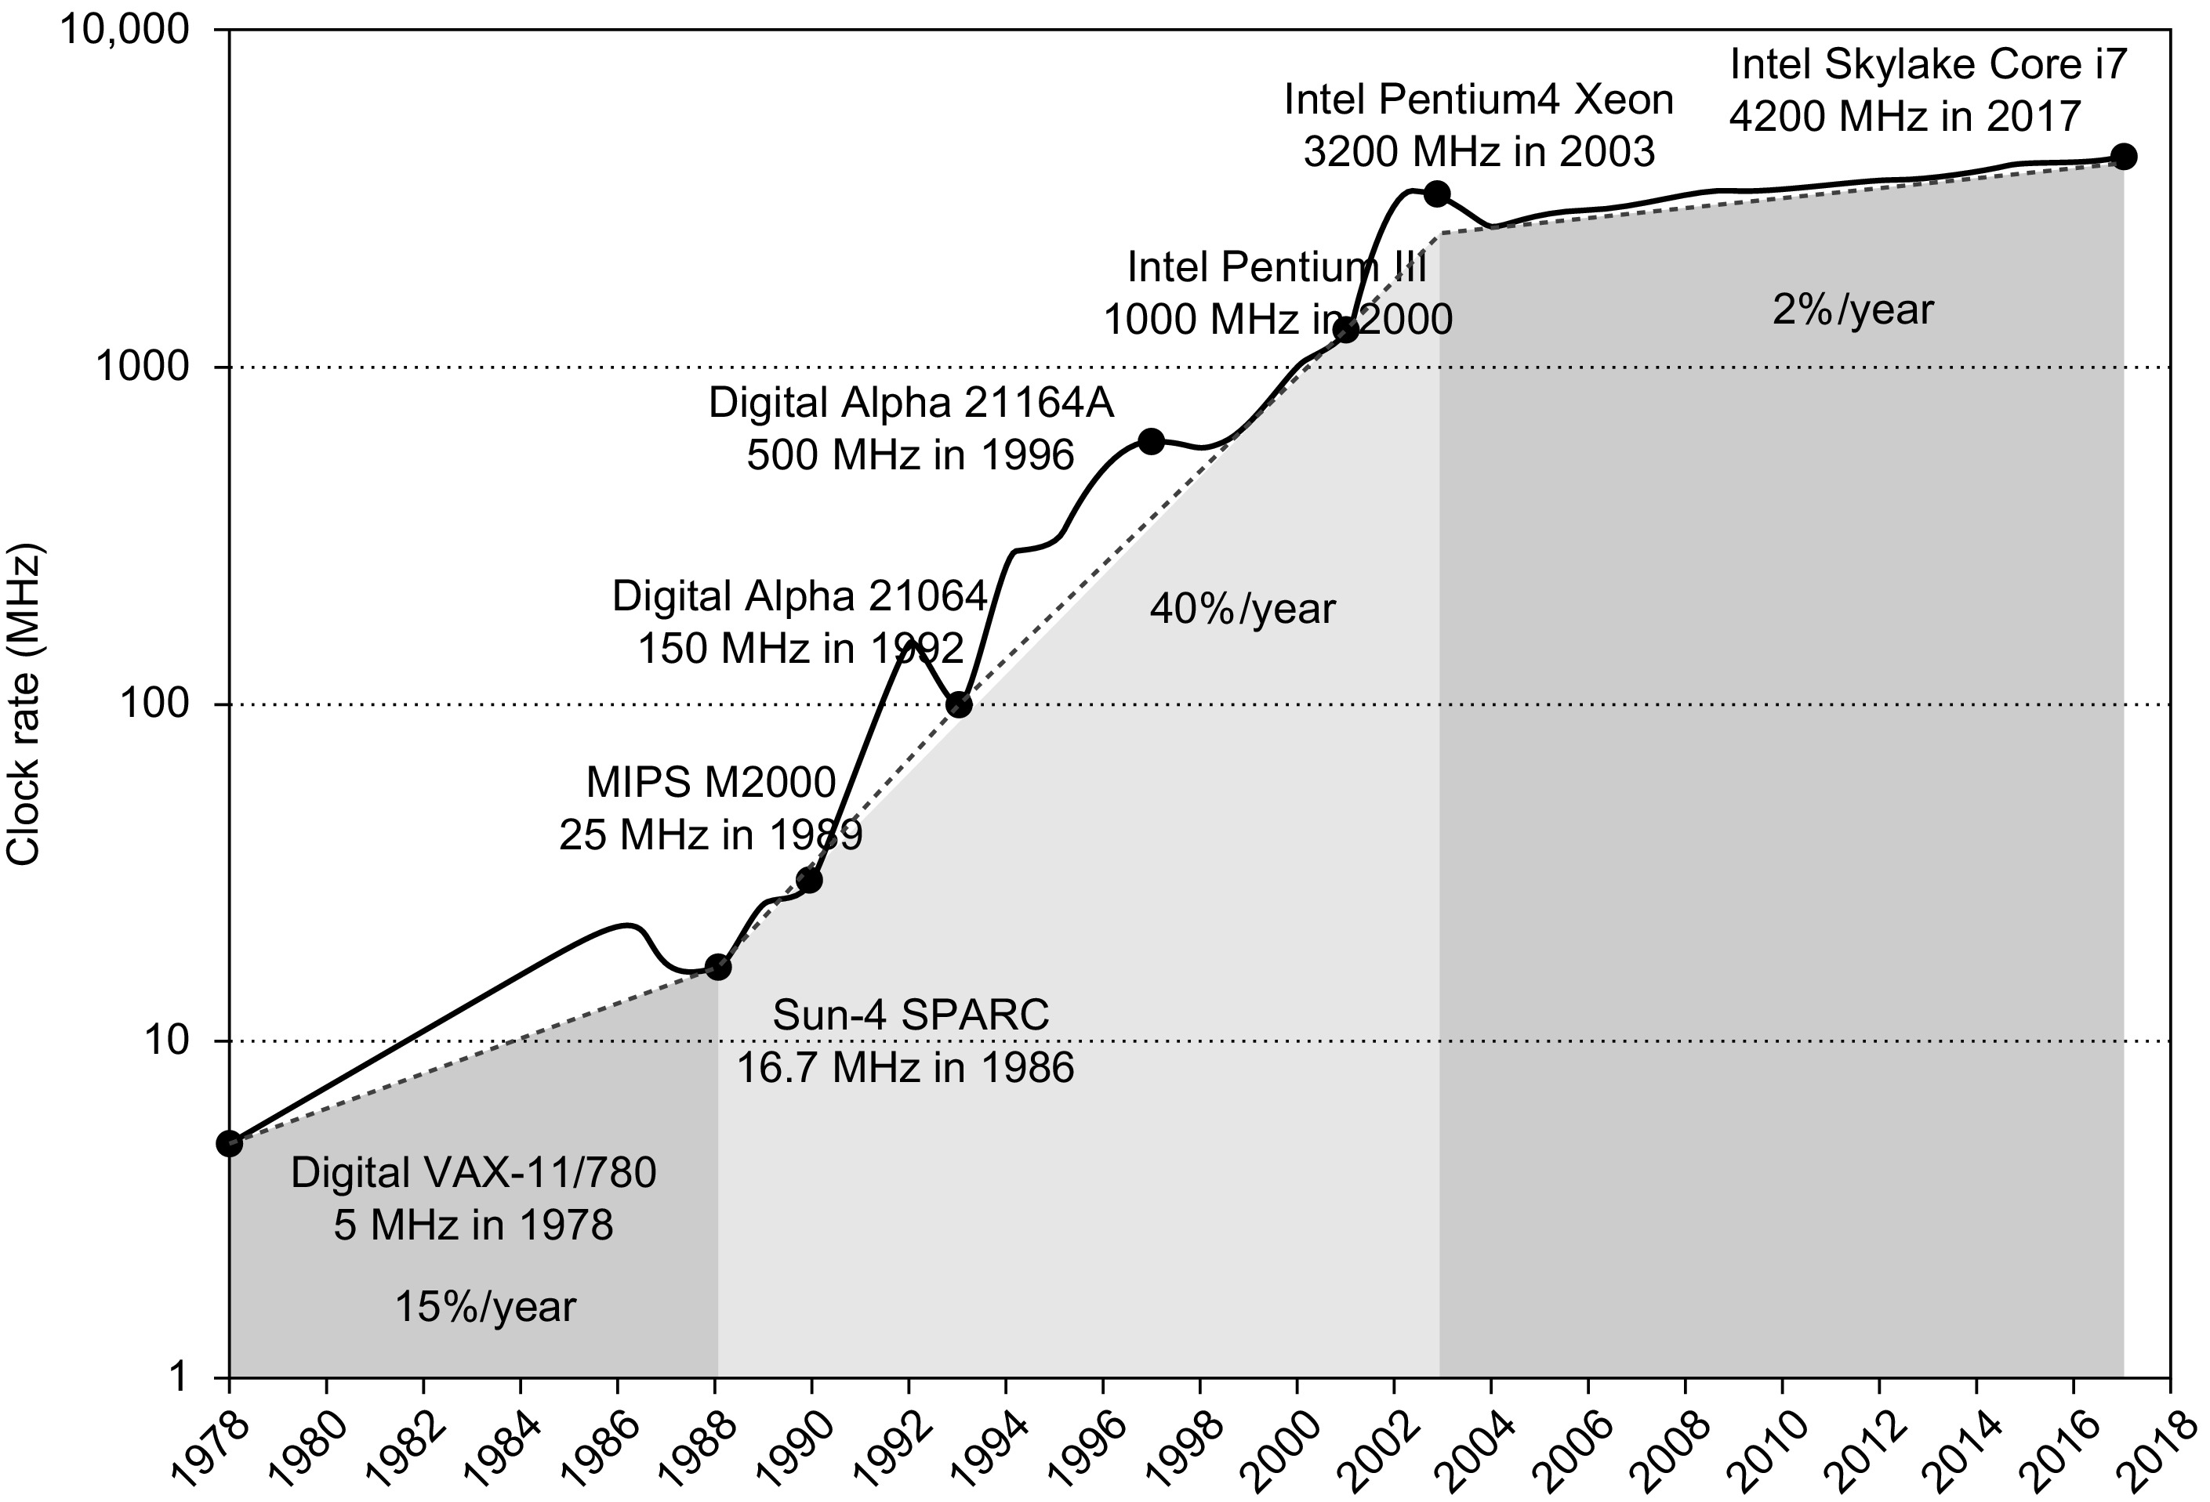
Power Consumption of a Transistor
slow down clock frequency growth toward power efficiency
Notes:
Figure1.11 Growth in clock rate of microprocessors in Figure1.1. Between 1978 and 1986, the clock rate improved less than 15% per year while performance improved by 22% per year. During the “renaissance period” of 52% per- formance improvement per year between 1986 and 2003, clock rates shot up almost 40% per year. Since then, the clock rate has been nearly flat, growing at less than 2% per year, while single processor performance improved recently at just 3.5% per year.
Given the preceding equation, you would expect clock frequency growth to slow down if we can’t reduce voltage or increase power per chip. Figure 1.11 shows that this has indeed been the case since 2003, even for the microprocessors in Figure 1.1 that were the highest performers each year. Note that this period of flatter clock rates corresponds to the period of slow performance improvement range in Figure 1.1.

Slide 35
Power Consumption of a Transistor
For a fixed task, slowing clock rate (frequency) reduces power,
but not energy.
Notes:
The power to keep a transistor active can be quantified like this.
As the expression demonstrates, for a fixed task, slowing clock rate / frequency reduces power;
However, it does not necessarily reduce energy.

Slide 36
Power Consumption of a Transistor
For a fixed task, slowing clock rate (frequency) reduces power,
but not energy.
Why?
Notes:
Why is this?

Slide 37
Power Consumption of a Transistor
For a fixed task, slowing clock rate (frequency) reduces power,
but not energy.
Why?
energy = power x execution-time
Notes:
Remember that energy equals to power times execution time

Slide 38
Power Consumption of a Transistor
For a fixed task, slowing clock rate (frequency) reduces power,
but not energy.
Why?
energy = power x execution-time
Notes:
When clock rate reduces, frequency decreases, then the execution time increases.

Slide 39
Challenges
Distributing the power
Removing the heat
Preventing hot spots
Cooling @ Google Data Center
Notes:
the challenges faced when designing power and energy solutions are distributing power, removing heat, and preventing hot spots.

Slide 40
How to economize energy?
Notes:
To improve energy efficiency,

Slide 41
Improve Energy-Efficiency
1. do nothing well
turn off the clock of inactive modules
2. DVFS: dynamic voltage-frequency scaling
scale down clock frequency and voltage during periods of low activity
Notes:
we have several possible directions.
A straightforward one is turn off the clock of inactive modules; (for example, if no floating-point instructions are executing, the clock of the floating-point unit is disabled. If some cores are idle, their clocks are stopped.)
Second, since frequency and voltage decide the power, we can carefully tune clock frequency and voltage for lower energy cost while keep the processor functioning at the same time. (PMDs, laptops, and even servers have periods of low activity where there is no need to operate at the highest clock frequencies and voltages. Modern microprocessors typically offer a few clock frequencies and voltages in which to operate that use lower power and energy.)

Slide 42
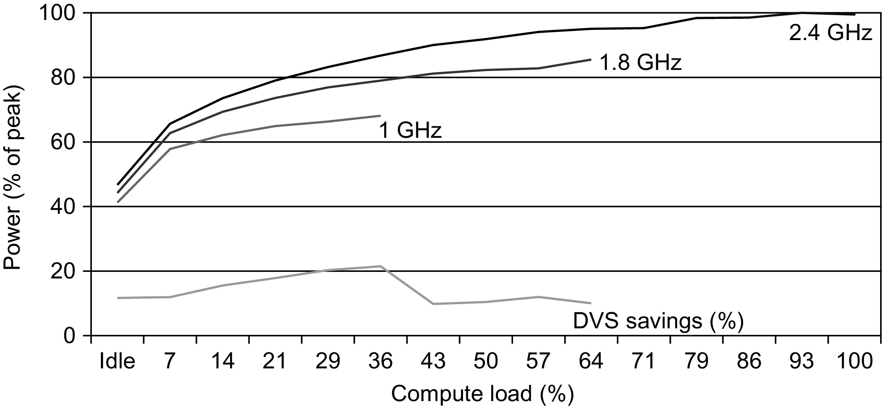
Improve Energy-Efficiency
1. do nothing well
turn off the clock of inactive modules
2. DVFS: dynamic voltage-frequency scaling
Notes:
we have several possible directions.
A straightforward one is turn off the clock of inactive modules; (for example, if no floating-point instructions are executing, the clock of the floating-point unit is disabled. If some cores are idle, their clocks are stopped.)
Second, since frequency and voltage decide the power, we can carefully tune clock frequency and voltage for lower energy cost while keep the processor functioning at the same time.
(Figure 1.12 plots the potential power savings via DVFS for a server as the work- load shrinks for three different clock rates: 2.4, 1.8, and 1 GHz. The overall server power savings is about 10%–15% for each of the two steps.)

Slide 43
Improve Energy-Efficiency
3. design for typical case
PMDs, laptops – often idle
memory and storage with low power modes to save energy
4. overclocking – Turbo mode
the chip runs at a higher clock rate for a short time until temperature rises
Notes:
3. For particular devices like PMDs and laptops, since they are often idle, their memory and storage are designed to offer low power modes to save energy
4. Some processor can also work in Turbo mode, that is, the chip runs at a higher clock rate for a short time toward faster processing speed until temperature rises.
Design for the typical case. Given that PMDs and laptops are often idle, mem- ory and storage offer low power modes to save energy. For example, DRAMs have a series of increasingly lower power modes to extend battery life in PMDs and laptops, and there have been proposals for disks that have a mode that spins more slowly when unused to save power. However, you cannot access DRAMs or disks in these modes, so you must return to fully active mode to read or write, no matter how low the access rate. As mentioned, microprocessors for PCs have been designed instead for heavy use at high operating temperatures, relying on on-chip temperature sensors to detect when activity should be reduced automat- ically to avoid overheating. This “emergency slowdown” allows manufacturers to design for a more typical case and then rely on this safety mechanism if some- one really does run programs that consume much more power than is typical.
4. Overclocking.IntelstartedofferingTurbomodein2008,wherethechipdecides that it is safe to run at a higher clock rate for a short time, possibly on just a few cores, until temperature starts to rise. For example, the 3.3 GHz Core i7 can run in short bursts for 3.6 GHz. Indeed, the highest-performing microprocessors each year since 2008 shown in Figure 1.1 have all offered temporary overclock- ing of about 10% over the nominal clock rate. For single-threaded code, these microprocessors can turn off all cores but one and run it faster. Note that, although the operating system can turn off Turbo mode, there is no notification once it is enabled, so the programmers may be surprised to see their programs vary in performance because of room temperature!

Slide 44

Static Power
Need power to maintain the storage values (e.g., SRAM)
Proportional to the number of devices
Notes:
Although dynamic power is traditionally thought of as the primary source of power dissipation in CMOS, static power is becoming an important issue because leakage current flows even when a transistor is off.

Slide 45
Beyond Transistors
Processor is just a portion of the whole energy cost
Race-to-halt
a faster, less energy-efficient processor
to more quickly complete tasks,
for the rest of the system to go into sleep mode
Notes:
But overall, processor is just a portion of the entire computer system, many other components consume energy;
In this sense, we can use a faster processor to more quickly complete tasks, even though this may induce more energy cost to processor, but less energy cost induced by other system components;

Slide 46
Trends
Technology
Power and Energy
Cost
Notes:
Now the third part, how computer cost evolves.
The use of technology improvements to lower cost, as well as increase performance, has been a major theme in the computer industry.

Slide 47
cost decreases even without technology improvement
Notes:
The cost of a manufactured computer component decreases over time even without significant improvements in the basic implementation technology.

Slide 48
Various Impacts
Time
learning curve: manufacturing costs decrease over time
Volume
costs decrease about 10% for each doubling of volume
Commoditization
competition among suppliers and their volume efficiency
Notes:
The underlying principle that drives costs down is the learning curve—manufacturing costs decrease over time. The learning curve itself is best measured by change in yield—the percentage of manufactured devices that survives the testing procedure. Whether it is a chip, a board, or a system, designs that have twice the yield will have half the cost.
Volume is a second key factor in determining cost. Increasing volumes affect cost in several ways. First, they decrease the time needed to get through the learn- ing curve, which is partly proportional to the number of systems (or chips) man- ufactured. Second, volume decreases cost because it increases purchasing and manufacturing efficiency. As a rule of thumb, some designers have estimated that costs decrease about 10% for each doubling of volume. Moreover, volume decreases the amount of development costs that must be amortized by each com- puter, thus allowing cost and selling price to be closer and still make a profit.
Commodities are products that are sold by multiple vendors in large volumes and are essentially identical. Virtually all the products sold on the shelves of gro- cery stores are commodities, as are standard DRAMs, Flash memory, monitors, and keyboards. In the past 30 years, much of the personal computer industry has become a commodity business focused on building desktop and laptop com- puters running Microsoft Windows.
Because many vendors ship virtually identical products, the market is highly competitive. Of course, this competition decreases the gap between cost and selling price, but it also decreases cost. Reductions occur because a commodity market has both volume and a clear product definition, which allows multiple suppliers to compete in building components for the commodity product. As a result, the over- all product cost is lower because of the competition among the suppliers of the components and the volume efficiencies the suppliers can achieve. This rivalry has led to the low end of the computer business being able to achieve better price-performance than other sectors and has yielded greater growth at the low end, although with very limited profits (as is typical in any commodity business).

Slide 49
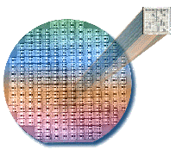
Integrated Circuit
wafer for test; chopped into dies for
packaging
Notes:
During production, integrated circuit is manufactured in the unit of wafer;
A wafer is then chopped into dies for final packaging.

Slide 50
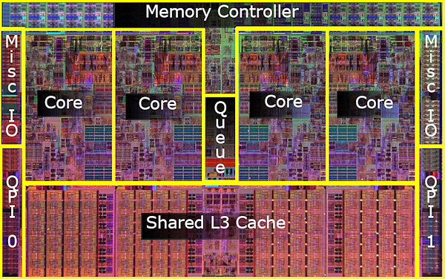
Example: Intel Core i7 Die
Notes:
Here’s an example of what an Intel Core i7 die looks like.

Slide 51
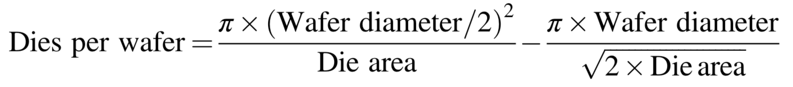
Dies per Wafer
Notes:
How many dies on a wafer?
The number of dies per wafer is approximately the area of the wafer divided by the area of the die.
You might need some geometry knowledge to derive this equation

Slide 52
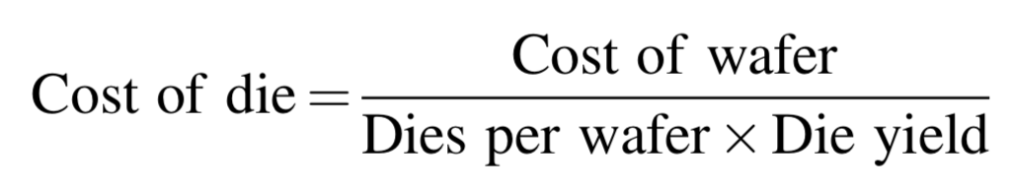
Cost per Die
percentage of manufactured devices that survives the testing procedure
Notes:
Since not all dies on wafer may function well,
When estimating the cost of functional die, we should take into account the fail rate.
In particular, we introduce a concept called die yield, it represents the percentage of manufactured devices that survives the testing.
Then the cost of die can be defined as cost of wafer over the number of functioning dies chopped from the wafer.

Slide 53
Die Yield
process-complexity factor for measuring manufacturing difficulty
Notes:
Here’s the equation for estimating die yield
It involves a manufacture factor called process-complexity factor;
This is usually not required for exam.

Slide 54
How to raise die yield?
Notes:
Given the tremendous price pressures on commodity products such as DRAM and SRAM, how to raise/improve die yield?

Slide 55
How to raise die yield?
Redundancy!
DRAMs/SRAMs have regularly included
some redundant memory cells so that
some flaws can be accommodated
Notes:
Given the tremendous price pressures on commodity products such as DRAM and SRAM, how to raise/improve die yield?

Slide 56
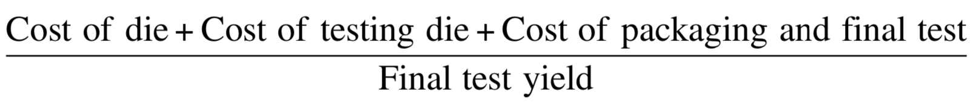
Cost of Integrated Circuit =
Notes:
Putting previous cost together, the cost of integrated circuit can be calculated like this.

Slide 57
Cost vs Price
Cost
to manufacture a product
Price
the product sells for
Notes:
With the commoditization of computers, the margin between the cost to manufacture a product and the price the product sells for has been shrinking.

Slide 58
Cost vs Price
Price = Cost + Margin
Margin
R&D, marketing, sales, manufacturing equipment maintenance, building rental, cost of financing, pretax profits, and taxes
Notes:
Those margins pay for a company’s research and development (R&D), marking, sales, manufacturing equipment maintenance, building rental, cost of financing, pretax profits, and taxes.
“Many engineers are surprised to find that most companies spend only 4% (in the commodity PC business) to 12% (in the high-end server business) of their income on R&D, which includes all engineering.”

Slide 59
Cost vs Price
Price = Cost + Margin
Margin
R&D, marketing, sales, manufacturing equipment maintenance, building rental, cost of financing, pretax profits, and taxes
4%~12% of income spent on R&D
Notes:
Those margins pay for a company’s research and development (R&D), marking, sales, manufacturing equipment maintenance, building rental, cost of financing, pretax profits, and taxes.
“Many engineers are surprised to find that most companies spend only 4% (in the commodity PC business) to 12% (in the high-end server business) of their income on R&D, which includes all engineering.”

Slide 60
Manufacturing vs Operation
Traditionally, only cost to build a computer and price to purchase one
Currently, WSCs contain tens of thousands of servers and need a significant cost to operate
Notes:
For the first four editions of this book, cost meant the cost to build a computer and price meant price to purchase a computer. With the advent of WSCs, which contain tens of thousands of servers, the cost to operate the computers is significant in addi- tion to the cost of purchase. Economists refer to these two costs as capital expenses (CAPEX) and operational expenses (OPEX).
As Chapter 6 shows, the amortized purchase price of servers and networks is about half of the monthly cost to operate a WSC, assuming a short lifetime of the IT equipment of 3–4 years. About 40% of the monthly operational costs are for power use and the amortized infrastructure to distribute power and to cool the IT equipment, despite this infrastructure being amortized over 10–15 years. Thus, to lower operational costs in a WSC, computer architects need to use energy efficiently.

Slide 61
Manufacturing vs Operation
Traditionally, only cost to build a computer and price to purchase one
Capital Expenses (CAPEX)
Currently, WSCs contain tens of thousands of servers and need a significant cost to operate
Operational Expenses (OPEX)
Notes:
Economists refer to these two costs as captial expenses (CAPEX) and operational expenses (opex).

Slide 62
Feature size is shrinking to 5 nm or smaller.
Notes:
As we can see, transistors keep shrinking
Most current transistors are down to 16 nanometers or even smaller;

Slide 63
Transient/permanent faults become more commonplace.
Notes:
Such tiny size puts a lot of challenges to manufacturing transistors,
in other words, transient or permanent faults are becoming more often to occur to transistors;

Slide 64
How to build dependable computers?
Notes:
Then how to cope with that?
How can we make our computers as dependable as possible?
Before answering this question,

Slide 65
Dependability
Is a system operating properly?
Notes:
We should know when can we say that a computer is dependable.
When we consider a computer as dependable, the computer should operate properly (according to function requirements)

Slide 66
Dependability
SLA: service level agreements
System states: up or down
Service states
service accomplishment
service interruption
failure
restoration
Notes:
For infrastructure providers to assure their customers the dependability of their networking or power service, they use service level agreements.
Per these agreements, system has up and down states while service has accomplishment and interruption states.
Service accomplishment: the service is delivered as specified;
Service interruption: the delivered service is different from the SLA (or SLO – Service Level Objectives)

Slide 67
Dependability
SLO: service level objectives
System states: up or down
Service states
service accomplishment
service interruption
failure
restoration
Notes:
For infrastructure providers to assure their customers the dependability of their networking or power service, they use service level agreements.
Per these agreements, system has up and down states while service has accomplishment and interruption states.
Service accomplishment: the service is delivered as specified;
Service interruption: the delivered service is different from the SLA (or SLO – Service Level Objectives)

Slide 68
Dependability
Computer system dependability is the quality of delivered service such that reliance can justifiably be placed on this service.
Notes:
Computer system dependability is the quality of delivered service such that reli- ance can justifiably be placed on this service. The service delivered by a system is its observed actual behavior as perceived by other system(s) interacting with this system’s users. Each module also has an ideal specified behavior, where a service specification is an agreed description of the expected behavior. A system failure occurs when the actual behavior deviates from the specified behavior. The failure occurred because of an error, a defect in that module. The cause of an error is a fault.

Slide 69
Dependability
The service delivered by a system is its observed actual behavior as perceived by other system(s) interacting with this system’s users.

Slide 70
Dependability
Each module also has an ideal specified behavior, where a service specification is an agreed description of the expected behavior.

Slide 71
Failure
A system failure occurs when the actual behavior deviates from the specified behavior.

Slide 72
Error, Fault
The failure occurred because of an error, a defect in that module.
The cause of an error is a fault.
When a fault occurs, it creates a latent error, which becomes effective when it is activated;
When the error actually affects the delivered service, a failure occurs.
Notes:
When a fault occurs, it creates a latent error, which becomes effective when it is activated; when the error actually affects the delivered service, a failure occurs.
The time between the occurrence of an error and the resulting failure is the error latency. Thus, an error is the manifestation in the system of a fault, and a failure is the manifestation on the service of an error.

Slide 73
Fault, Error, Failure
A fault creates one or more latent errors
Either an effective error is a formerly latent error in that component or it has propagated from another error in that component or from else where
A component failure occurs when the error affects the delivered service

Slide 74
Fault, Error, Failure
Failure
Error
Fault
affect the delivered service
activated to be effective
one or more latent errors
Notes:
A fault creates one or more latent errors.
The properties of errors are (1) a latent error becomes effective once acti- vated; (2) an error may cycle between its latent and effective states; and (3) an effective error often propagates from one component to another, thereby cre- ating new errors. Thus, either an effective error is a formerly latent error in that component or it has propagated from another error in that component or from elsewhere.
A component failure occurs when the error affects the delivered service.
These properties are recursive and apply to any component in the system.

Slide 75
Fault, Error, Failure
Fault example: program bug 60 + 35 = 90 latent error (not necessarily be called)

Slide 76
Fault, Error, Failure
Fault example: program bug 60 + 35 = 90 latent error (not necessarily be called)
Error example: activated fault call add(60,35) while registering grades oops…

Slide 77
Fault, Error, Failure
Fault example: program bug 60 + 35 = 90 latent error (not necessarily be called)
Error example: activated fault call add(60,35) while registering grades oops…
Failure example: submit add(60,35)=90 → 4.5/5.0

Slide 78
Fault, Error, Failure
Fault example: program bug 60 + 35 = 90 latent error (not necessarily be called)
Error example: activated fault call add(60,35) while registering grades oops…
Failure example: submit add(60,35)=90 → 4.5/5.0
Non-failure example: submit if(add(60,35)>=86) → 4.0/4.0

Slide 79
How to measure dependability?
Notes:
To measure dependability,

Slide 80
Measures of Dependability
Module reliability
Module availability
Notes:
Two main metrics are module reliability and module availability

Slide 81
Module Reliability
A measure of continuous service accomplishment (or of the time to failure) from a reference initial instant
MTTF: mean time to failure
MTTR: mean time to repair
MTBF: mean time between failures
MTBF = MTTF + MTTR
1st failure
2nd failure
Notes:
Module reliability is a measure of …
three terms of interest are mttf, mttr, and mtbf;
Service interruption is measured as mean time to repair.
Obviously, mtbf=mttf+mttr;

Slide 82
Module Reliability
FIT: failures per billion hours
MTTF of 1,000,000 hours
= 1/10⁶ x 10⁹
= 1000 FIT
1 failure per 1 million hours
Notes:
we also use FIT to measure module reliability.
Here’s how FIT is defined and its relation between mttf

Slide 83
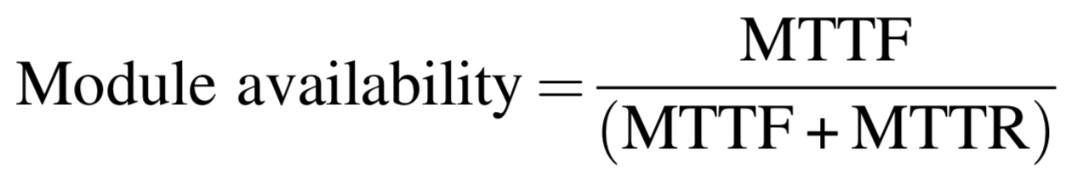
Module Availability
Notes:
Module availability represents the time ratio of system working properly till failure
(Module availability is a measure of the service accomplishment with respect to the alternation between the two states of accomplishment and interruption.)

Slide 84
Module Availability
Notes:
Specifically, during mttf, system works properly

Slide 85
Module Availability
Notes:
Then take some time to repair, during which system is not working, not available

Slide 86
Module Availability
Notes:
So the module availability can be quantified as the fraction of the working time over the whole time frame;

Slide 87
MTTF: Example 1
Assume a disk subsystem with the following components and MTTF:
10 disks, each read at 10⁶-hour MTTF;
1 ATA controller, 500,000-hour MTTF;
1 power supply, 200,000-hour MTTF;
1 fan, 200,000-hour MTTF;
1 ATA cable, 1,000,000-hour MTTF;
Assume expo-distributed lifetimes and independent failures
Compute MTTF of the whole system?

Slide 88
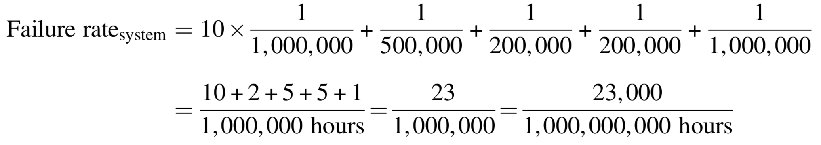
MTTF: Example 1
The sum of the failure rates:
The MTTF of the system:
Notes:
The MTTF of the system is just the inverse of the failure rate.

Slide 89
MTTF: Example 2
Assume 1000 disks with a 10,000,000-hour MTTF and used 24hr/day, upon disk failures, replace with disks of the same dependability;
The number of failed disks per year?

Slide 90
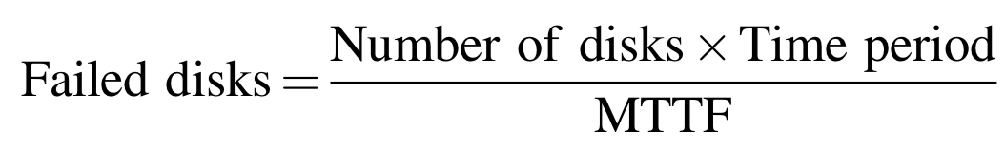
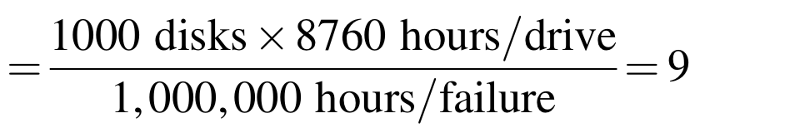
MTTF: Example 2
Assume 1000 disks with a 10,000,000-hour MTTF and used 24hr/day, upon disk failures, replace with disks of the same dependability;
The number of failed disks per year?

Slide 91
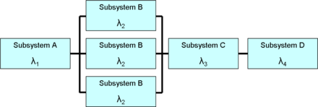
Dependability via Redundancy
in time
repeat the operation to see if it still is erroneous
in resources
have other components to take over from the one that failed
Notes:
The primary way to cope with failure is redundancy,
Either in time or in resources

Slide 92
Redundancy
Notes:
A bit tricky to derive the formulae, so directly copy the text from textbook (for ease of understanding), xixi

Slide 93
Disk Arrays
Disk arrays with redundant disks to tolerate faults
If a single disk fails, the lost information is reconstructed from redundant information
RAID: redundant array of inexpensive/independent disks
Notes:
Although a disk array would have more faults than a smaller number of larger disks when each disk has the same reliability, dependability is improved by add- ing redundant disks to the array to tolerate faults. That is, if a single disk fails, the lost information is reconstructed from redundant information. The only danger is in having another disk fail during the mean time to repair (MTTR). Since the mean time to failure (MTTF) of disks is tens of years, and the MTTR is measured in hours, redundancy can make the measured reliability of many disks much higher than that of a single disk.
Such redundant disk arrays have become known by the acronym RAID, which originally stood for redundant array of inexpensive disks, although some prefer the word independent for I in the acronym. The ability to recover from fail- ures plus the higher throughput, measured as either megabytes per second or I/Os per second, make RAID attractive. When combined with the advantages of smaller size and lower power of small-diameter drives, RAIDs now dominate large-scale storage systems.

Slide 94
Disk Arrays
Disk arrays with redundant disks to tolerate faults
If a single disk fails, the lost information is reconstructed from redundant information
RAID: redundant array of inexpensive/independent disks
versus Striping: simply spreading data over multiple disks
Notes:
a comparison other, using multiple disks without data redundancy
Striping: simply spreading data over multiple disks – high overhead
Simply spreading data over multiple disks, called striping, automatically forces accesses to several disks if the data files are large.

Slide 95
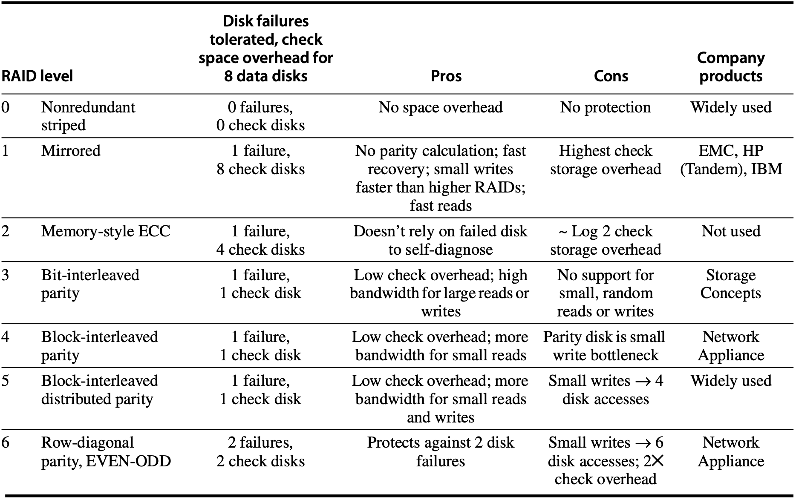
RAID
Notes:
Six types of RAID designs
Except RAID 0, which is named so solely for comparison

Slide 96
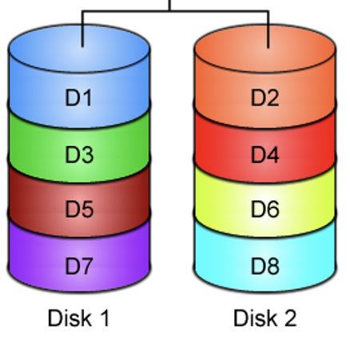
RAID 0
JBOD: just a bunch of disks
No redundancy
No failure tolerated
Stripe data across disks
Measuring stick for other RAID levels: cost, performance, and dependability
https://www.icc-usa.com/content/raid-calculator/raid-0-1.png
Notes:
RAID 0—It has no redundancy and is sometimes nicknamed JBOD, for just a bunch of disks, although the data may be striped across the disks in the array. This level is generally included to act as a measuring stick for the other RAID levels in terms of cost, performance, and dependability.

Slide 97
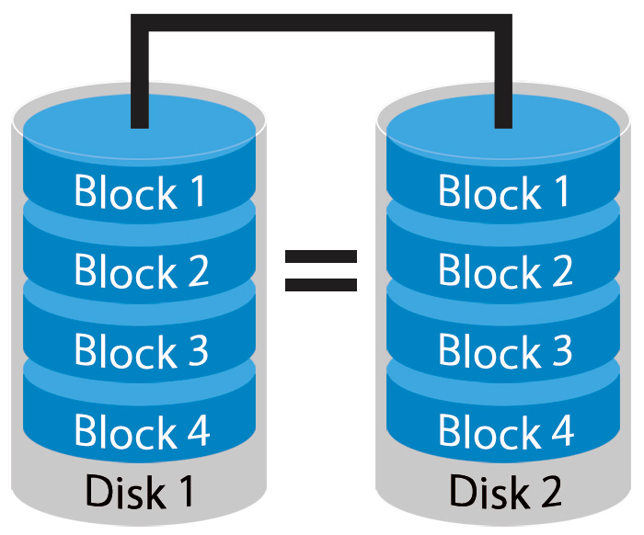
RAID 1
Mirroring or Shadowing
Two copies for every piece of data
one logical write = two physical writes
100% capacity/space
overhead
http://www.petemarovichimages.com/wp-content/uploads/2013/11/RAID1.jpg
Notes:
RAID 1—Also called mirroring or shadowing, there are two copies of every piece of data. It is the simplest and oldest disk redundancy scheme, but it also has the highest cost. Some array controllers will optimize read performance by allowing the mirrored disks to act independently for reads, but this optimi- zation means it may take longer for the mirrored writes to complete. (as both copies on both disks need to be written; i.e., parallel writes are required for one data block)

Slide 98
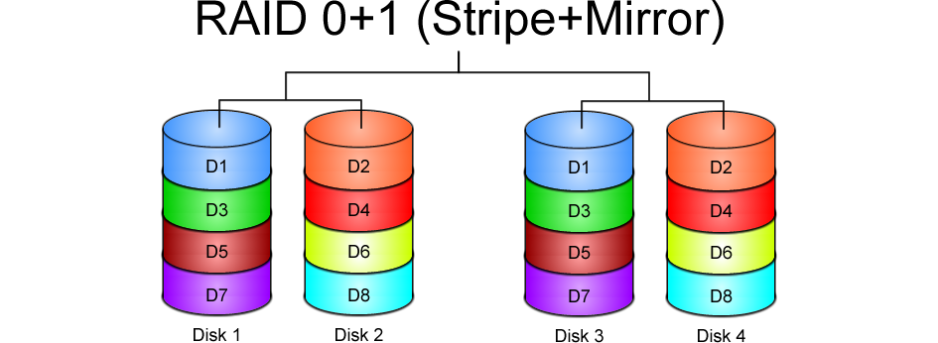
https://www.icc-usa.com/content/raid-calculator/raid-0-1.png

Slide 99
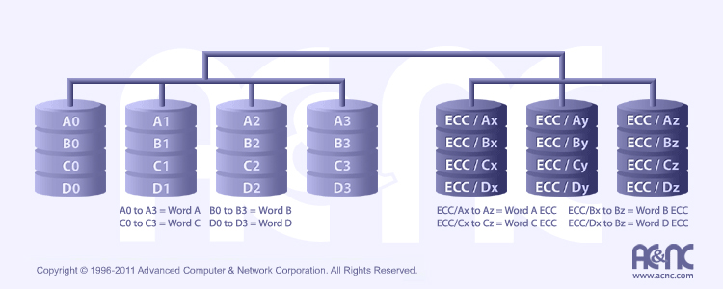
RAID 2
http://www.acnc.com/raidedu/2
Each bit of data word is written to a data disk drive
Each data word has its (Hamming Code) ECC word recorded on the ECC disks
On read, the ECC code verifies correct data or corrects single disk errors
data disks
ECC disks
Notes:
Each bit of data word is written to a data disk drive, accompanied with the word’s ECC spread over the ECC disks
Bit-level
RAID 2—This organization was inspired by applying memory-style error- correcting codes (ECCs) to disks. It was included because there was such a disk array product at the time of the original RAID paper, but none since then as other RAID organizations are more attractive.

Slide 100
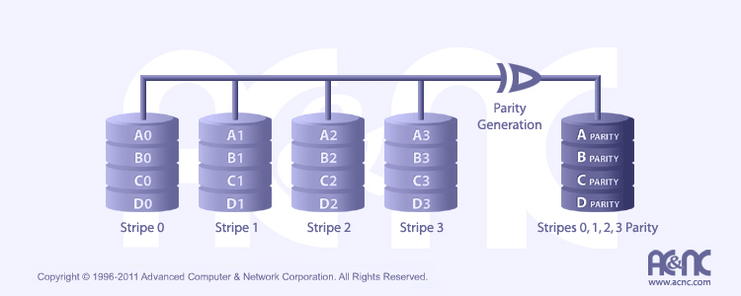
RAID 3
http://www.acnc.com/raidedu/3
Data striped over all data disks
Parity of a stripe to parity disk
Require at least 3 disks to implement
Notes:
RAID 3—Since the higher-level disk interfaces understand the health of a disk, it’s easy to figure out which disk failed. Designers realized that if one extra disk contains the parity of the information in the data disks, a single disk allows recovery from a disk failure. The data are organized in stripes, with N data blocks and one parity block. When a failure occurs, we just “sub- tract” the good data from the good blocks, and what remains is the missing data. (This works whether the failed disk is a data disk or the parity disk.) RAID 3 assumes that the data are spread across all disks on reads and writes, which is attractive when reading or writing large amounts of data.
Byte-level

Slide 101
RAID 3
Even Parity
parity bit makes
the # of 1 even
p = sum(data1) mod 2
P
1
0
1
0
0
0
1
1
1
1
0
0
1
1
0
1
1
0
1
0
0
0
1
1
1
1
0
0
1
1
0
1

Slide 102
RAID 3
Even Parity
parity bit makes
the # of 1 even
p = sum(data1) mod 2
Recovery
if a disk fails,
“subtract” good data
from good blocks;
what remains is missing data;
P
1
0
1
0
0
0
1
1
1
0
1
0
0
0
1
1
1
1
0
0
1
1
0
1

Slide 103
RAID 3
“subtract”
1 – 1 = 0
1 – 0 = 1
0 – 1 = 1
0 – 0 = 0
Even Parity
parity bit makes
the # of 1 even
p = sum(data1) mod 2
Recovery
if a disk fails,
“subtract” good data
from p of good blocks;
what remains is missing data;
P
1
0
1
0
0
0
1
1
1
1
0
0
1
1
0
1
1
0
1
0
0
0
1
1
1
1
0
0
1
1
0
1

Slide 104

RAID 4
http://www.acnc.com/raidedu/4
Favor small accesses
Allows each disk to perform independent reads, using sectors’ own error checking
independent read - not read across multiple disks
Notes:
RAID 4—Many applications are dominated by small accesses. Since sectors have their own error checking, you can safely increase the number of reads per second by allowing each disk to perform independent reads. It would seem that writes would still be slow, if you have to read every disk to calculate parity. To increase the number of writes per second, an alternative approach involves only two disks. First, the array reads the old data that are about to be overwritten, and then calculates what bits would change before it writes the new data. It then reads the old value of the parity on the check disks, updates parity according to the list of changes, and then writes the new value of parity to the check disk. Hence, these so-called “small writes” are still slower than small reads—they involve four disks accesses—but they are faster than if you had to read all disks on every write. RAID 4 has the same low check disk overhead as RAID 3, and it can still do large reads and writes as fast as RAID 3 in addition to small reads and writes, but control is more complex.

Slide 105
RAID 3 & RAID 4
bottleneck:
single parity disk
access:
parallel vs independent

Slide 106
RAID 3 & RAID 4
? bottleneck:
single parity disk
access:
parallel vs independent
Notes:
How to address the bottleneck due to a single parity disk?
Spread parity bits across more disks --- RAID 5

Slide 107
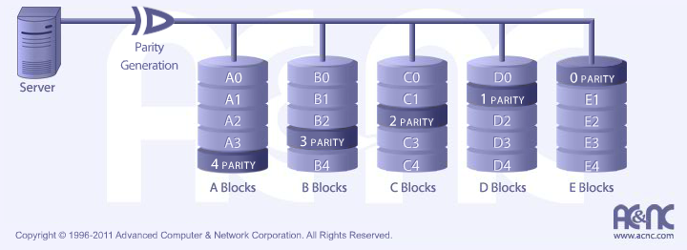
RAID 5
http://www.acnc.com/raidedu/5
Distributes the parity info across all disks in the array
Removes the bottleneck of a single parity disk as in RAID 3 and RAID 4
Notes:
RAID 5—Note that a performance flaw for small writes in RAID 4 is that they all must read and write the same check disk, so it is a performance bottleneck. RAID 5 simply distributes the parity information across all disks in the array, thereby removing the bottleneck. The parity block in each stripe is rotated so that parity is spread evenly across all disks. The disk array controller must now calculate which disk has the parity for when it wants to write a given block, but that can be a simple calculation. RAID 5 has the same low check disk overhead as RAID 3 and 4, and it can do the large reads and writes of RAID 3 and the small reads of RAID 4, but it has higher small write band- width than RAID 4. Nevertheless, RAID 5 requires the most sophisticated controller of the classic RAID levels.

Slide 108
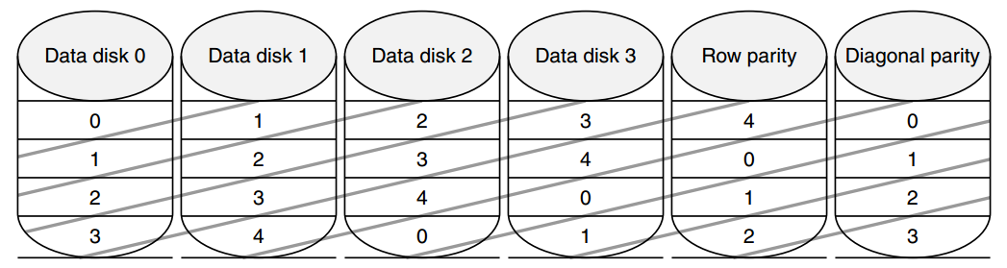
RAID 6: Row-diagonal Parity
RAID-DP
Recover from two failures
xor⊕
row: 00⊕11⊕22⊕33=r4
diagonal: 01⊕11⊕31⊕r1=d1

Slide 109
RAID 6: Row-diagonal Parity
RAID-DP
Recover from two failures
xor⊕
row: 00⊕11⊕22⊕33=r4
diagonal: 01⊕11⊕31⊕r1=d1

Slide 110
Double-Failure Recovery

Slide 111
Double-Failure Recovery

Slide 112
Double-Failure Recovery

Slide 113
Double-Failure Recovery

Slide 114
Double-Failure Recovery

Slide 115
Double-Failure Recovery

Slide 116
Double-Failure Recovery

Slide 117
Double-Failure Recovery

Slide 118
Double-Failure Recovery

Slide 119
Double-Failure Recovery

Slide 120
Double-Failure Recovery

Slide 121
Double-Failure Recovery

Slide 122
Double-Failure Recovery

Slide 123
RAID: Further Readings
RAID Types – Classifications
BytePile.com
https://www.icc-usa.com/content/raid-calculator/raid-0-1.png
RAID
JetStor
http://www.acnc.com/raidedu/0

Slide 124
RAID: Further Readings
More error detection and recovery schemes
Reed Solomon coding: https://www.youtube.com/watch?v=jgO09opx56o
Erasure coding, etc.

Slide 125
How to measure performance?
Notes:
Having quantified the cost, power, and dependability of computer technology, we are ready to quantify performance.
As aforementioned, we have two common metrics to measure performance, right?

Slide 126
Measure Performance
Execution/response time
the time between the start and
the completion of an event
Throughput
the total amount of work done in a given time
Notes:
One is execution time (or response time, or latency);
The other is throughput…;

Slide 127

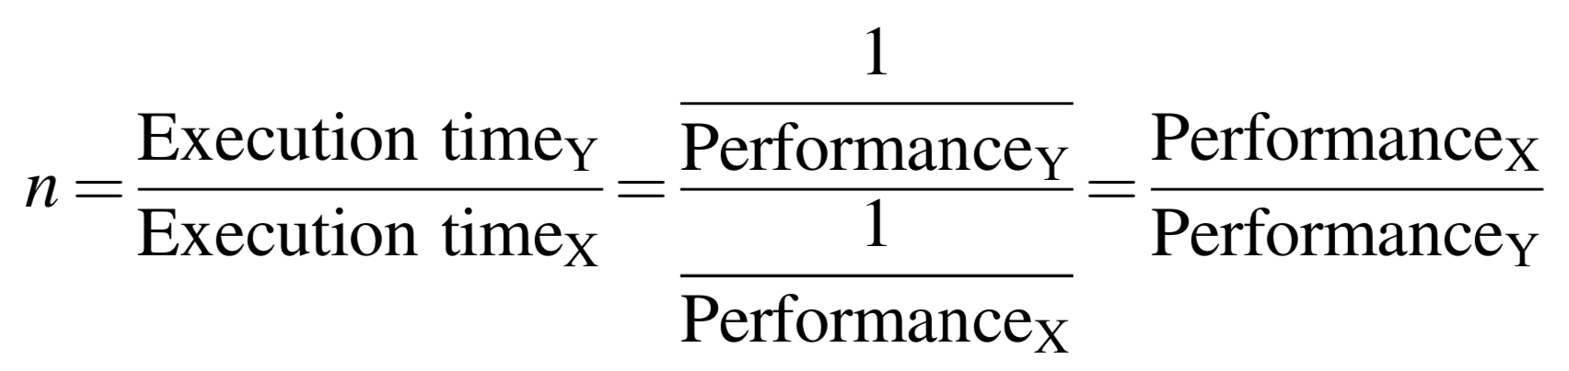
Measure Performance
Computers: X and Y
X is n times faster than Y, if
Notes:
X is faster than Y: the response time or execution time is lower on X than on Y for the given task.
Since execution time is the reciprocal of performance, then the following relationship holds:
The throughput of X is 1.3 times as fast as Y – the number of tasks completed per unit time on computer X is 1.3 times the number completed on Y.

Slide 128
CPU Time
The time the processor is computing, not including the time waiting for I/O or running other programs

Slide 129
Elapsed Time
Wall-clock time / response time seen by user: the latency to complete a task, including strorage accesses, memory accesses, I/O activities, operating system overhead

Slide 130
Elapsed Time
Wall-clock time / response time seen by user: the latency to complete a task? including strorage accesses, memory accesses, I/O activities, operating system overhead

Slide 131
Benchmarks
Programs that many companies use to establish the relative performance of their computers
Benchmark suites: collections of benchmark applications
SPEC: Standard Performance Evaluation Corporation

Slide 132
Desktop Benchmarks
Two classes: processor-intensive benchmarks graphics-intensive benchmarks
SPEC CPU2017 https://www.spec.org/cpu2017/ 20 SPECspeed benchmarks 23 SPECrate benchmarks

Slide 133
Desktop Benchmarks
Two classes: processor-intensive benchmarks graphics-intensive benchmarks
SPEC CPU2017 https://www.spec.org/cpu2017/ 20 SPECspeed benchmarks _s suffix time metric

Slide 134
Desktop Benchmarks
Two classes: processor-intensive benchmarks graphics-intensive benchmarks
SPEC CPU2017 https://www.spec.org/cpu2017/ 23 SPECrate benchmarks _r suffix throughput metric

Slide 135
Desktop Benchmarks
Two classes: processor-intensive benchmarks graphics-intensive benchmarks
SPECrate@2017 10 integer benchmarks (CINT2017) 13 floating-point benchmarks (CFP2017)

Slide 136
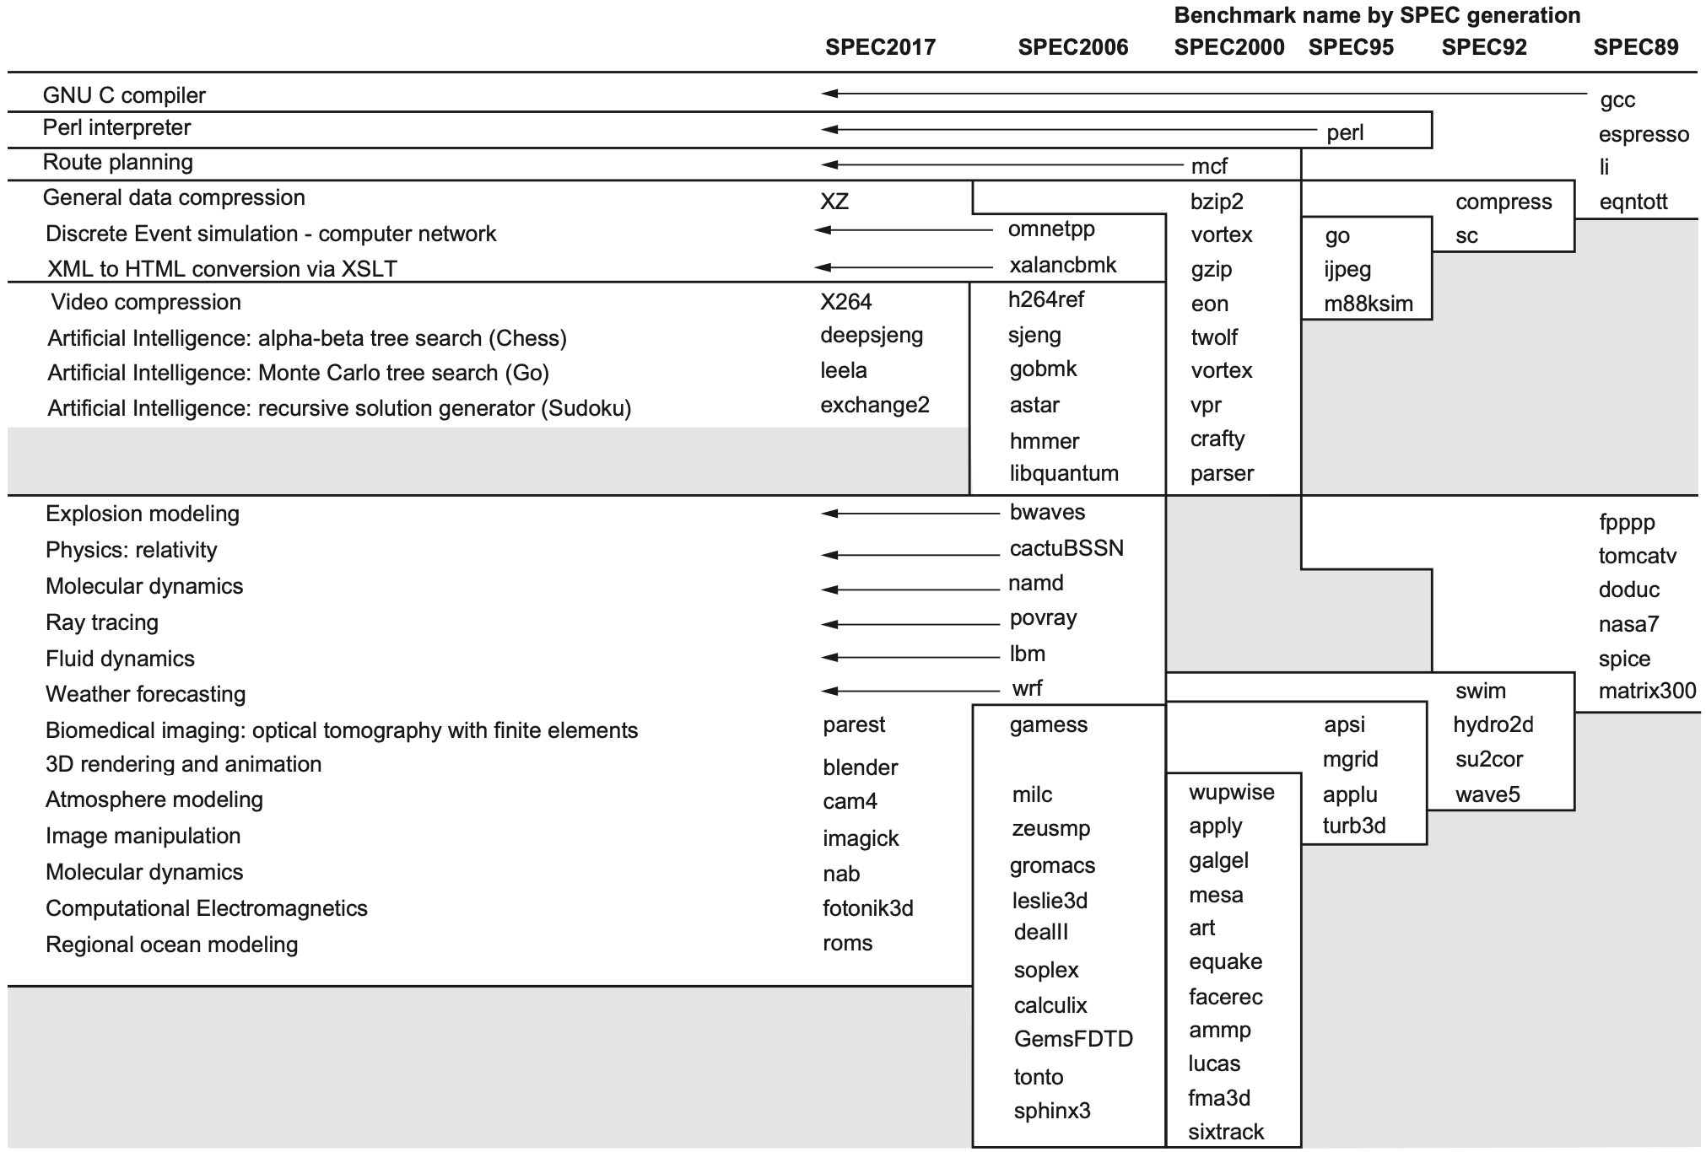
SPECrate@2017
integer
floating-point
Notes:
Figure 1.17 SPEC2017 programs and the evolution of the SPEC benchmarks over time, with integer programs above the line and floating- point programs below the line. Of the 10 SPEC2017 integer programs, 5 are written in C, 4 in C++., and 1 in Fortran. For the floating-point programs, the split is 3 in Fortran, 2 in C++, 2 in C, and 6 in mixed C, C++, and Fortran. The figure shows all 82 of the programs in the 1989, 1992, 1995, 2000, 2006, and 2017 releases. Gcc is the senior citizen of the group. Only 3 integer programs and 3 floating-point programs survived three or more generations. Although a few are carried over from generation to generation, the version of the program changes and either the input or the size of the benchmark is often expanded to increase its running time and to avoid perturbation in measurement or domination of the execution time by some factor other than CPU time. The benchmark descriptions on the left are for SPEC2017 only and do not apply to earlier versions. Programs in the same row from different generations of SPEC are generally not related; for example, fpppp is not a CFD code like bwaves.

Slide 137
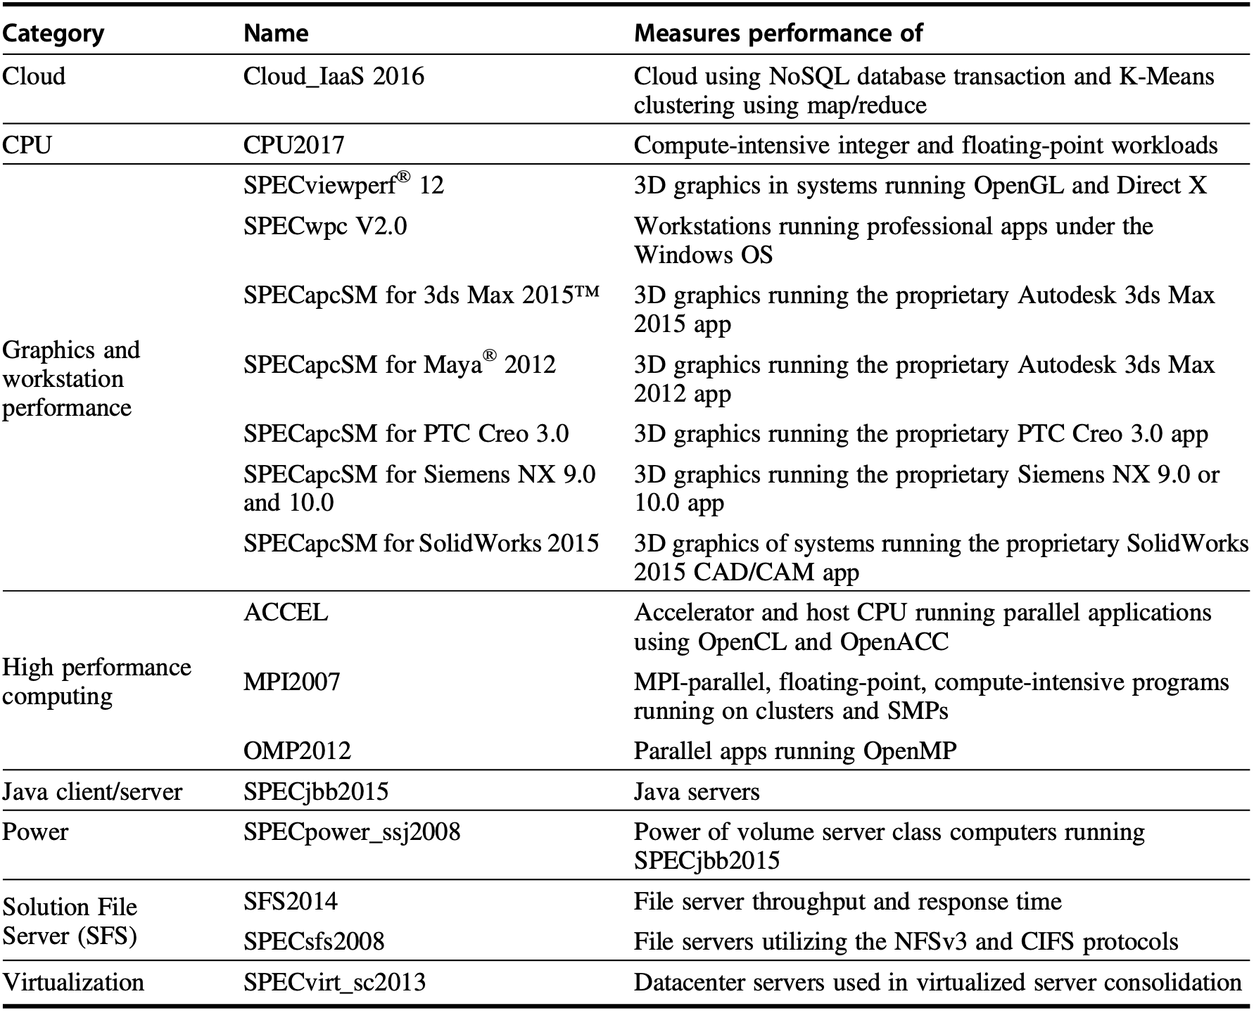
Server Benchmarks

Slide 138
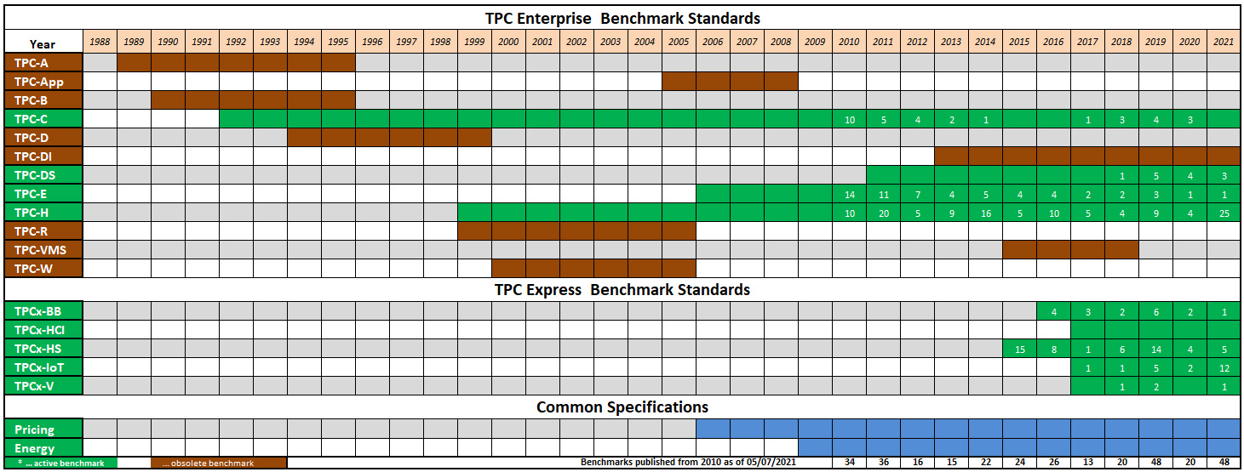
Server Benchmarks
TPC: Transaction Processing Council
Examples: TPC-C for complext query environment TPC-E for brokerage customer accounts
http://tpc.org/information/benchmarks5.asp

Slide 139
Report Performance
Guiding principle
reproductivity
Requirement
list everything another experiment would need to duplicate the results
Notes:
The guiding principle of reporting performance measurements should be repro- ducibility—list everything another experimenter would need to duplicate the results. A SPEC benchmark report requires an extensive description of the com- puter and the compiler flags, as well as the publication of both the baseline and the optimized results. In addition to hardware, software, and baseline tuning parameter descriptions, a SPEC report contains the actual performance times, shown both in tabular form and as a graph. A TPC benchmark report is even more complete, because it must include results of a benchmarking audit and cost information. These reports are excellent sources for finding the real costs of com- puting systems, since manufacturers compete on high performance and cost- performance.

Slide 140
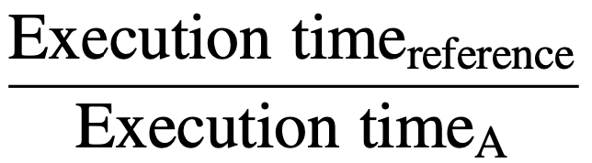
Summarize Performance
SPECRatio
normalize execution times to a reference computer by dividing the time on the reference computer by the time on the computer being rated
Notes:
Rather than pick weights, we could normalize execution times to a reference computer by dividing the time on the reference computer by the time on the computer being rated, yielding a ratio proportional to performance. SPEC uses this approach, calling the ratio the SPECRatio. It has a particularly useful property that matches the way we benchmark computer performance throughout this text—namely, comparing performance ratios.
Notice that the execution times on the reference computer drop out and the choice of the reference computer is irrelevant when the comparisons are made as a ratio, which is the approach we consistently use.

Slide 141
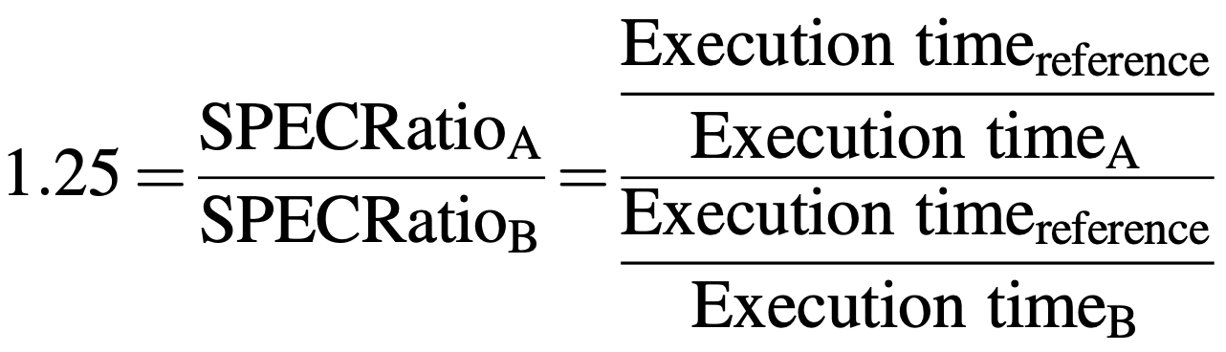
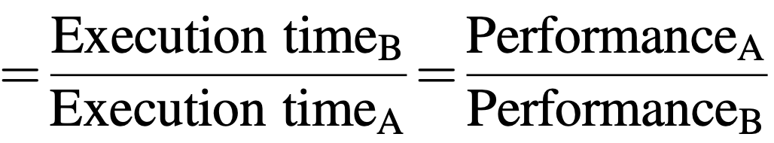
Summarize Performance
SPECRatio
normalize execution times to a reference computer by dividing the time on the reference computer by the time on the computer being rated
Computer A
is 1.25 times
as fast as Computer B
Notes:
Rather than pick weights, we could normalize execution times to a reference computer by dividing the time on the reference computer by the time on the computer being rated, yielding a ratio proportional to performance. SPEC uses this approach, calling the ratio the SPECRatio. It has a particularly useful property that matches the way we benchmark computer performance throughout this text—namely, comparing performance ratios.
Notice that the execution times on the reference computer drop out and the choice of the reference computer is irrelevant when the comparisons are made as a ratio, which is the approach we consistently use.

Slide 142

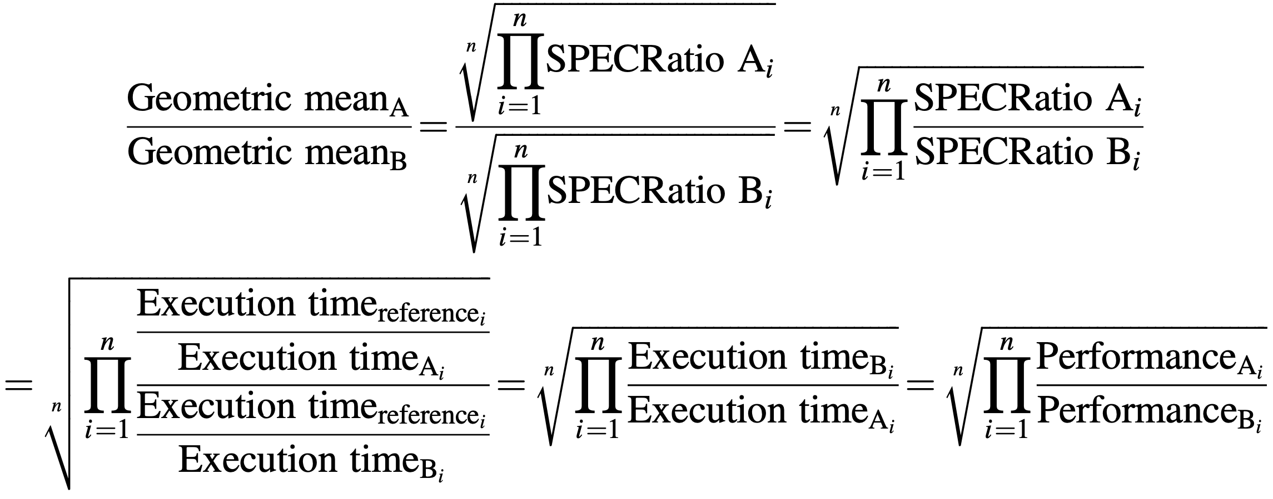
Compare Performance
Use geometric mean of samples (i.e., program SPECRatio)
Compare performance of two computers

Slide 143
Compare Performance
Use geometric mean of samples (i.e., program SPECRatio)
Compare performance of two computers
reference computer is irrelevant

Slide 144
Finally, quantitative principles of computer design
Notes:
Now we have seen how to define, measure, and summarize/report performance, cost, dependability, energy, and power,
We can explore guidelines and principals that are useful in the design and analysis of computers.
Which are called quantitative principles;

Slide 145
Quantitative Principles
Parallelism
Locality
temporal locality: recently accessed items are likely to be accessed in the near future;
spatial locality: items whose addresses are near one another tend to be referenced close together in time
Notes:
Parallelism – lec02:
ILP: Instruction-Level Parallelism
Vector Architectures, GPUs, and MM
TLP: Thread-Level Parallelism
RLP: Request-Level Parallelism

Slide 146
Data Locality
sum=0;
for(i=0; i<n; i++)
sum+=a[i];
return sum;

Slide 147
Data Locality
sum=0;
for(i=0; i<n; i++)
sum+=a[i];
return sum;
Temporal locality: sum
Spatial locality: a[i]

Slide 148
Instruction Locality
sum=0;
for(i=0; i<n; i++)
sum+=a[i];
return sum;

Slide 149
Instruction Locality
sum=0;
for(i=0; i<n; i++)
sum+=a[i];
return sum;
Temporal locality: cycle through loop repeatedly
Spatial locality: referece instructions in sequence

Slide 150
Quantitative Principles
A program spends
90% of its execution time in only 10% of its code
Parallelism
Locality
temporal locality: recently accessed items are likely to be accessed in the near future;
spatial locality: items whose addresses are near one another tend to be referenced close together in time
Notes:
A widely held rule of thumb is that a program spends 90% of its execution time in only 10% of the code.

Slide 151
Quantitative Principles
Focus on the Common Case
in making a design trade-off,
favor the frequent case over
the infrequent case
Notes:
Toward an better average performance
(Perhaps the most important and pervasive principle of computer design is to focus on the common case: in making a design trade-off, favor the frequent case over the infrequent case. This principle applies when determining how to spend resources, because the impact of the improvement is higher if the occurrence is commonplace. )

Slide 152
Quantitative Principles
Focus on the Common Case
in making a design trade-off,
favor the frequent case over
the infrequent case
How much faster by improving the common case?
Notes:
Toward an better average performance
(In applying this simply principle, we have to decide what the common case is and how much performance can be improved by making that case faster)

Slide 153
Quantitative Principles
Amdahl’s Law performance improvement to be gained from using some faster mode of execution is limited by the fraction of the time the faster mode can be used
Notes:
Amdahl’s law defines speedup
(A fundamental law, called Amdahl’s Law, can be used to quantify this principle. Amdahl’s Law states that the perfor- mance improvement to be gained from using some faster mode of execution is limited by the fraction of the time the faster mode can be used )

Slide 154
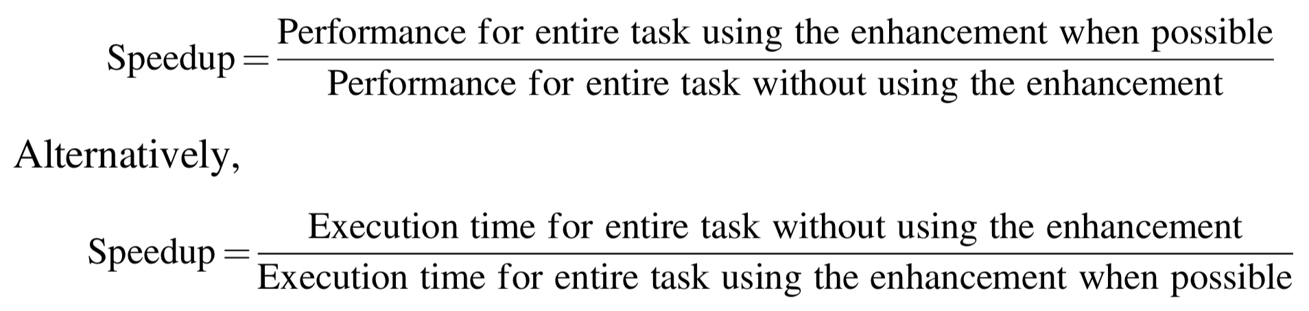
Quantitative Principles
Amdahl’s Law
Notes:
Amdahl’s law defines speedup
(A fundamental law, called Amdahl’s Law, can be used to quantify this principle. Amdahl’s Law states that the perfor- mance improvement to be gained from using some faster mode of execution is limited by the fraction of the time the faster mode can be used )

Slide 155
Amdahl’s Law: Two Factors
1. Fraction_{enhanced}:
e.g., 20/60 if 20 seconds out of a 60-second program to enhance
2. Speedup_{enhanced}:
e.g., 5/2 if enhanced to 2 seconds while originally 5 seconds
Notes:
Fraction-enhanced: The fraction of the computation time in the original computer that can be con- verted to take advantage of the enhancement;
Speedup-enhanced: The improvement gained by the enhanced execution mode, that is, how much faster the task would run if the enhanced mode were used for the entire program;
Then the execution time using the original computer with the enhanced mode will be the time spent using the unenhanced portion of the computer plus the time spent using the enhancement.

Slide 156
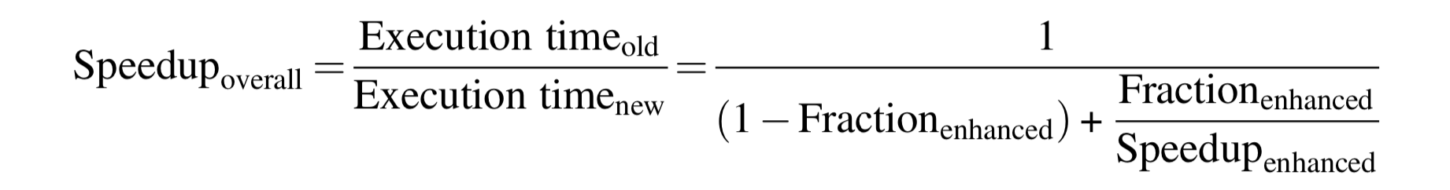
Amdahl’s Law: Overall Speedup
Notes:
The overall speed up is the ration of the execution time.

Slide 157
Amdahl’s Law: Overall Speedup
limit ~ 0
Notes:
The overall speed up is the ration of the execution time.

Slide 158
Amdahl’s Law: Overall Speedup
limit ~ 0
limit ~
1/(1-Fraction_{enhaced})
Notes:
The overall speed up is the ration of the execution time.
An important corollary of Amdahl’s Law is that if an enhancement is usable only for a fraction of a task, then we can’t speed up the task by more than the reciprocal of 1 minus that fraction.

Slide 159
Amdahl’s Law: Example 1
to enhance the processor for web serv;
new processor w/ 10 times faster comp;
40% computation and 60% I/O
(improve the infrequent case)
overall speedup?
Notes:
Suppose that we want to enhance the processor used for web serving. The new processor is 10 times faster on computation in the web serving application than the old processor. Assuming that the original processor is busy with computation 40% of the time and is waiting for I/O 60% of the time, what is the overall speedup gained by incorporating the enhancement?

Slide 160
Amdahl’s Law: Example 1
to enhance the processor for web serv;
new processor w/ 10 times faster comp;
40% computation and 60% I/O
(improve the infrequent case)
overall speedup?
Notes:
Suppose that we want to enhance the processor used for web serving. The new processor is 10 times faster on computation in the web serving application than the old processor. Assuming that the original processor is busy with computation 40% of the time and is waiting for I/O 60% of the time, what is the overall speedup gained by incorporating the enhancement?

Slide 161
Amdahl’s Law: Example 1
to enhance the processor for web serv;
new processor w/ 10 times faster comp;
40% computation and 60% I/O
(improve the infrequent case)
overall speedup?
40%
10
Notes:
Suppose that we want to enhance the processor used for web serving. The new processor is 10 times faster on computation in the web serving application than the old processor. Assuming that the original processor is busy with computation 40% of the time and is waiting for I/O 60% of the time, what is the overall speedup gained by incorporating the enhancement?

Slide 162
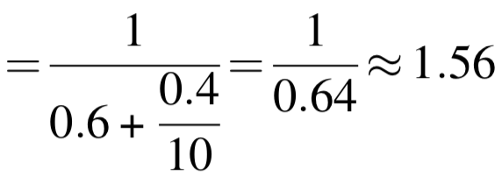
Amdahl’s Law: Example 1
to enhance the processor for web serv;
new processor w/ 10 times faster comp;
40% computation and 60% I/O
(improve the infrequent case)
overall speedup?
Notes:
Suppose that we want to enhance the processor used for web serving. The new processor is 10 times faster on computation in the web serving application than the old processor. Assuming that the original processor is busy with computation 40% of the time and is waiting for I/O 60% of the time, what is the overall speedup gained by incorporating the enhancement?

Slide 163
Amdahl’s Law: Example 2
20% FP square root for graphic apps;
design 1: improve hw for 10x speedup;
design 2: for all FP instructions (50% of the execution time), improve by 1.6x;
vote for design 1 or design 2?
Notes:
A common transformation required in graphics processors is square root. Imple- mentations of floating-point (FP) square root vary significantly in performance, especially among processors designed for graphics. Suppose FP square root (FSQRT) is responsible for 20% of the execution time of a critical graphics bench- mark. One proposal is to enhance the FSQRT hardware and speed up this operation by a factor of 10. The other alternative is just to try to make all FP instructions in the graphics processor run faster by a factor of 1.6; FP instructions are responsible for half of the execution time for the application. The design team believes that they can make all FP instructions run 1.6 times faster with the same effort as required for the fast square root. Compare these two design alternatives.

Slide 164
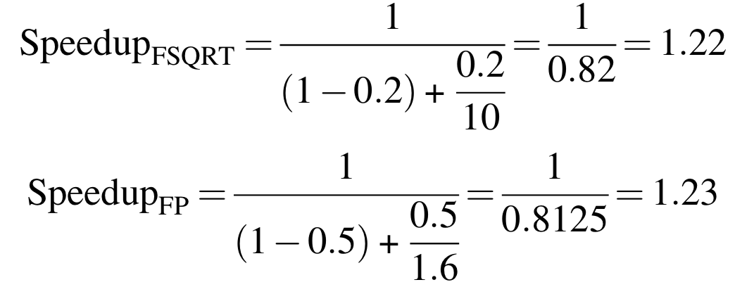
Amdahl’s Law: Example 2
20% FP square root for graphic apps;
design 1: improve hw for 10x speedup;
design 2: for all FP instructions (50% of the execution time), improve by 1.6x;
vote for design 1 or design 2?
Notes:
A common transformation required in graphics processors is square root. Imple- mentations of floating-point (FP) square root vary significantly in performance, especially among processors designed for graphics. Suppose FP square root (FSQRT) is responsible for 20% of the execution time of a critical graphics bench- mark. One proposal is to enhance the FSQRT hardware and speed up this operation by a factor of 10. The other alternative is just to try to make all FP instructions in the graphics processor run faster by a factor of 1.6; FP instructions are responsible for half of the execution time for the application. The design team believes that they can make all FP instructions run 1.6 times faster with the same effort as required for the fast square root. Compare these two design alternatives.

Slide 165
Processor Performance
Notes:
A series of processor performance equations ahead

Slide 166
CPU Time for Program
CPU time = CPU clock cycles for a program
x Clock cycle time
CPU time = CPU clock cycles for a program
Clock rate
CPU time =
Notes:
CPU time for a program can then be expressed in two ways.

Slide 167
CPI: Clock Cycles per Instruction
CPI = CPU clock cycles for a program
Instruction count
CPI =
Notes:
In addition to the number of clock cycles needed to execute a program, we can also count the number of instructions exeucted: the instruction path leength or instruction count (IC).
If we know the number of clock cycles and the instruction count, we can calculate the average number of clock cycles per instruction (CPI).

Slide 168
CPI: Clock Cycles per Instruction
CPI = CPU clock cycles for a program
Instruction count
IPC = Instruction count
CPU clock cycles for a program
CPI =
IPC =
Notes:
Designers sometimes also use instructions per clock (IPC), which is the inverse of CPI

Slide 169
CPI: Clock Cycles per Instruction
CPI = CPU clock cycles for a program
Instruction count
IPC =
CPI =
Clock cycles = IC x CPI
Instruction Count

Slide 170
CPI: Clock Cycles per Instruction
CPI = CPU clock cycles for a program
Instruction count
IPC =
CPI =
Clock cycles = IC x CPI
CPU time = Clock cycles x Clock cycle time
CPU time = IC x CPI x Clock cycle time
Notes:
Substitute clock cycles in the equation of cpu time with IC x CPI;
As this formula demonstrates, processor performance is dependent upon three characteristics:

Slide 171
Decisive Characteristics
Clock cycle time
hardware technology and organization
CPI
organization and ISA
Instruction count
ISA and compiler technology
Notes:
Clock cycle (or rate), clock cycles per instruction, and instruction count;
It is difficult to change one parameter in compelete isolation from others because the basic technologies involved in changing each characteristic are interdependent.

Slide 172

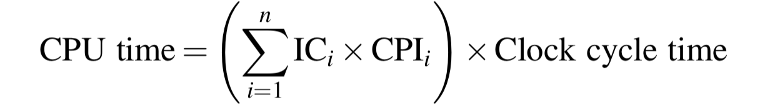
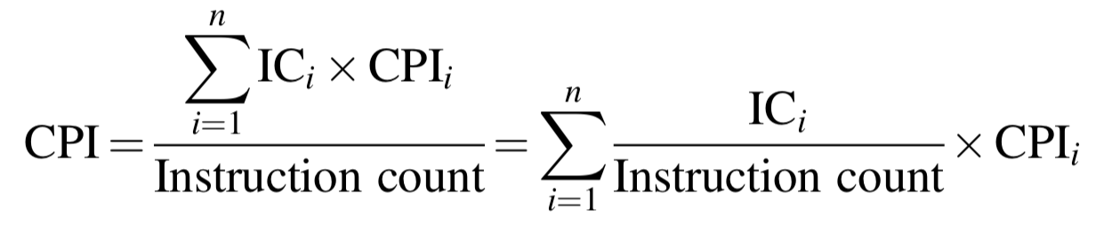
Multiple Instructions
Notes:
Where ICi represents the number of times instruction i is executed in a program and CPIi represents the average number of clocks per instruction for instruction i.

Slide 173
Review
Trends in technology, power, energy, and cost
Dependability
Performance
Quantitative principles

Slide 174
Quantitative Principles
Locality
Parallelism
Amdahl’s Law: focus on common case - fraction_{enhanced} speedup limit ~ 1/(1- fraction_{enhanced})

Slide 175
Chapter 1.4-1.9
Notes:
The teaching content corresponds to the second part of chapter 1.

Slide 176
?

Slide 177

Thank You
be you
Notes:
Some seagulls are floating in the ocean, some are hovering in the sky, while some is walking on the edge.
One way or another, just be you.

Slide 178
#What’s More
You and Your Research
by Richard Hamming
How to Write a Great Research Paper
by Simon Peyton Jones
How to Give a Great Research Talk
by Simon Peyton Jones
A Radical New Way to Control the English Language by George Gopen

Slide 179
#What’s More
How to Do Good Research
by Frédo Durand

